Slide 1
4-digit Numbers

Slide 2
How many blocks are there? Let’s count together!
1

Slide 3
How many blocks are there? Let’s count together!
10

Slide 4
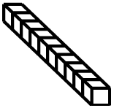
How many blocks are there? Let’s count together!
100

Slide 5
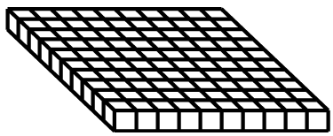
How many blocks are there? Let’s count together!
1000

Slide 6
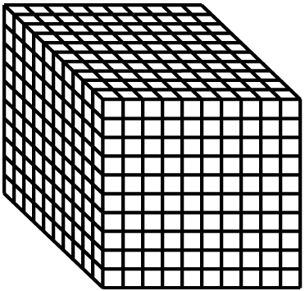
4-digit Numbers
1
10
100
1000

Slide 7
Weight
1g
10g
100g
1000g

Slide 8
Weight
1g
10g
100g
1000g

Slide 9
Weight
1g
10g
100g
1000g
How much do they weigh?

Slide 10
Weight
1g
10g
100g
1000g
How much do they weigh?

Slide 11
Weight
1g
10g
100g
1000g
How much do they weigh?

Slide 12
Weight
1g
10g
100g
1000g
How much do they weigh?

Slide 13
Weight
1g
10g
100g
1000g
How much do they weigh?

Slide 14
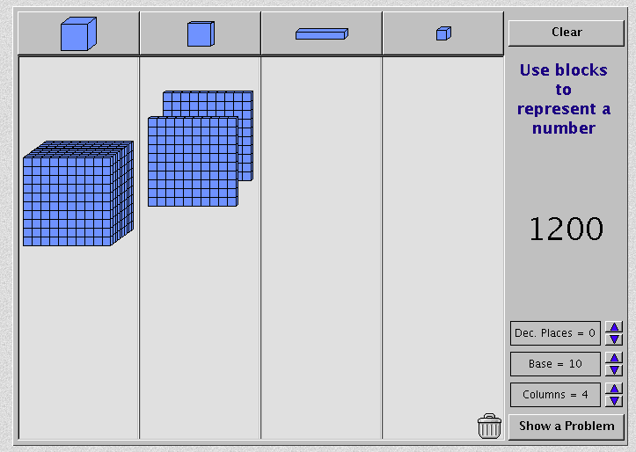
4-digit Numbers
http://nlvm.usu.edu/en/nav/frames_asid_152_g_2_t_1.html

