Slide 1
Gram and Kilogram

Slide 2
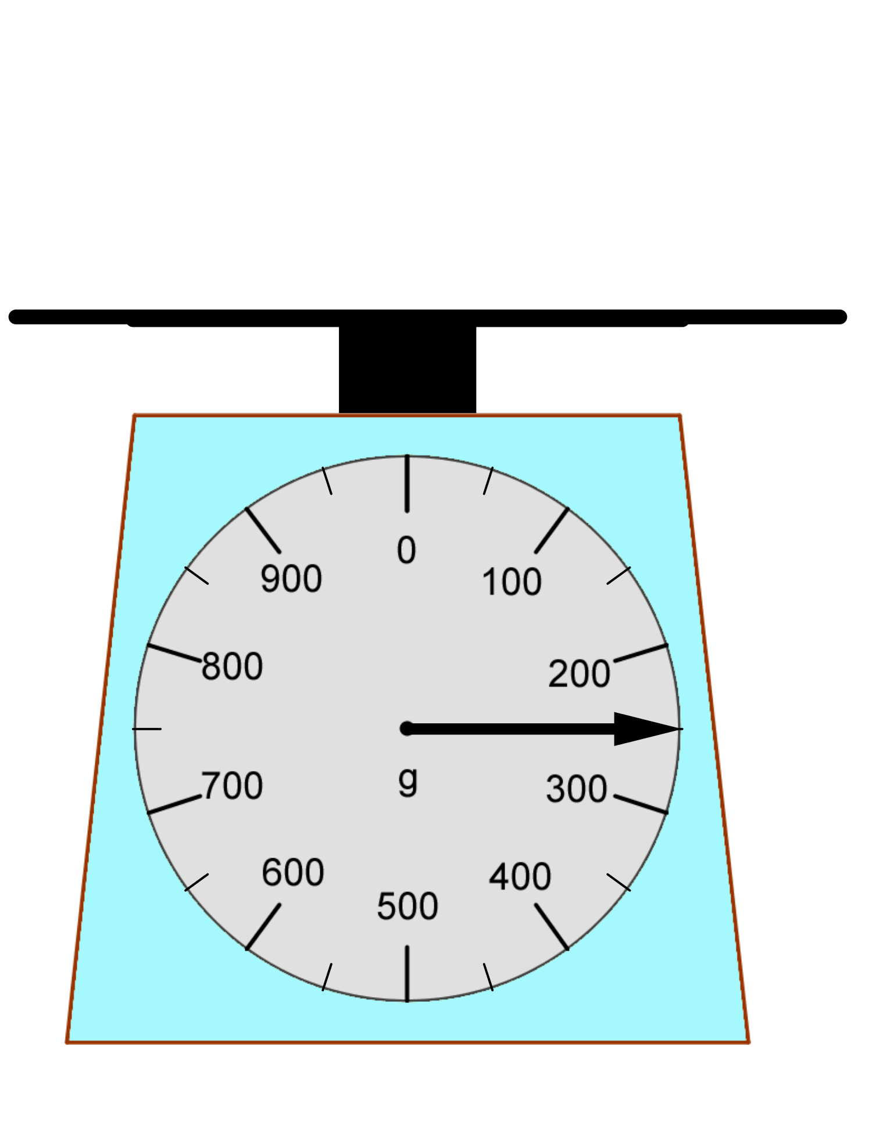
Recap
How to read a scale?
1. Read the unit
2. How heavy an interval represents?
3. How many sub-intervals?
4. How heavy a sub-interval represents?
The pointer points to the 1st sub-interval after 200g
So, it is 200g＋50g

Slide 3
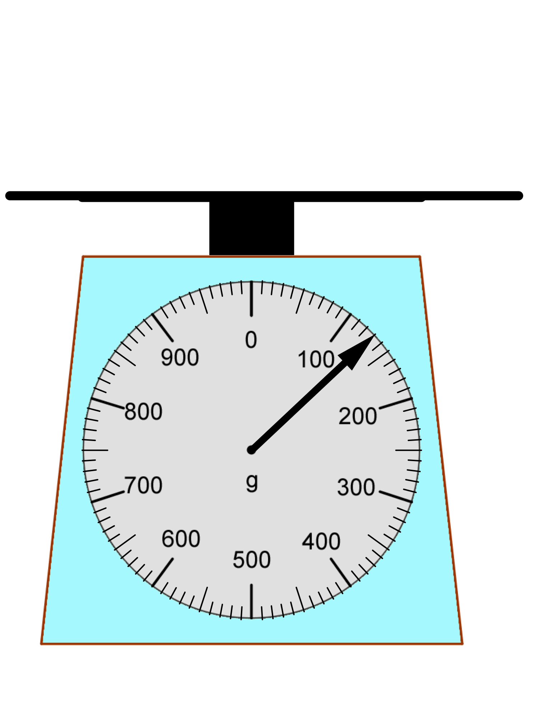
Recap
How to read a scale?
1. Read the unit
2. How heavy an interval represents?
3. How many sub-intervals?
4. How heavy a sub-interval represents?
The pointer points to the 3rd sub-interval after 100g
So, it is 100g＋30g

Slide 4
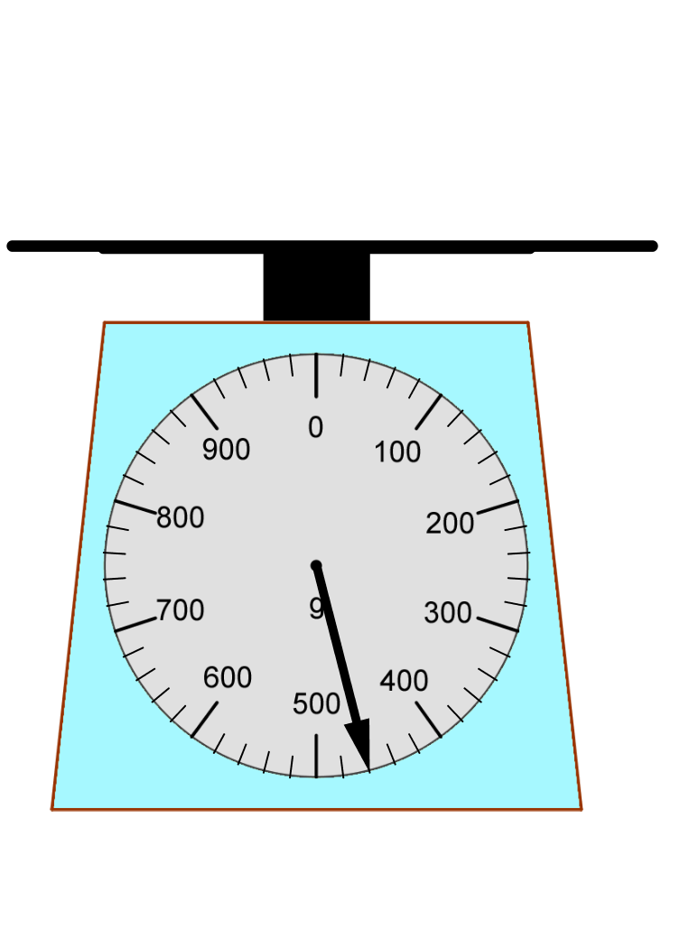
Recap
How to read a scale?
1. Read the unit
2. How heavy an interval represents?
3. How many sub-intervals?
4. How heavy a sub-interval represents?
The pointer points to the 3rd sub-interval after 400g
So, it is 400g＋60g

Slide 5
Recap
Is it 600g?
No! It is 2000g and 600g
2000g + 600g
= 2600g

Slide 6
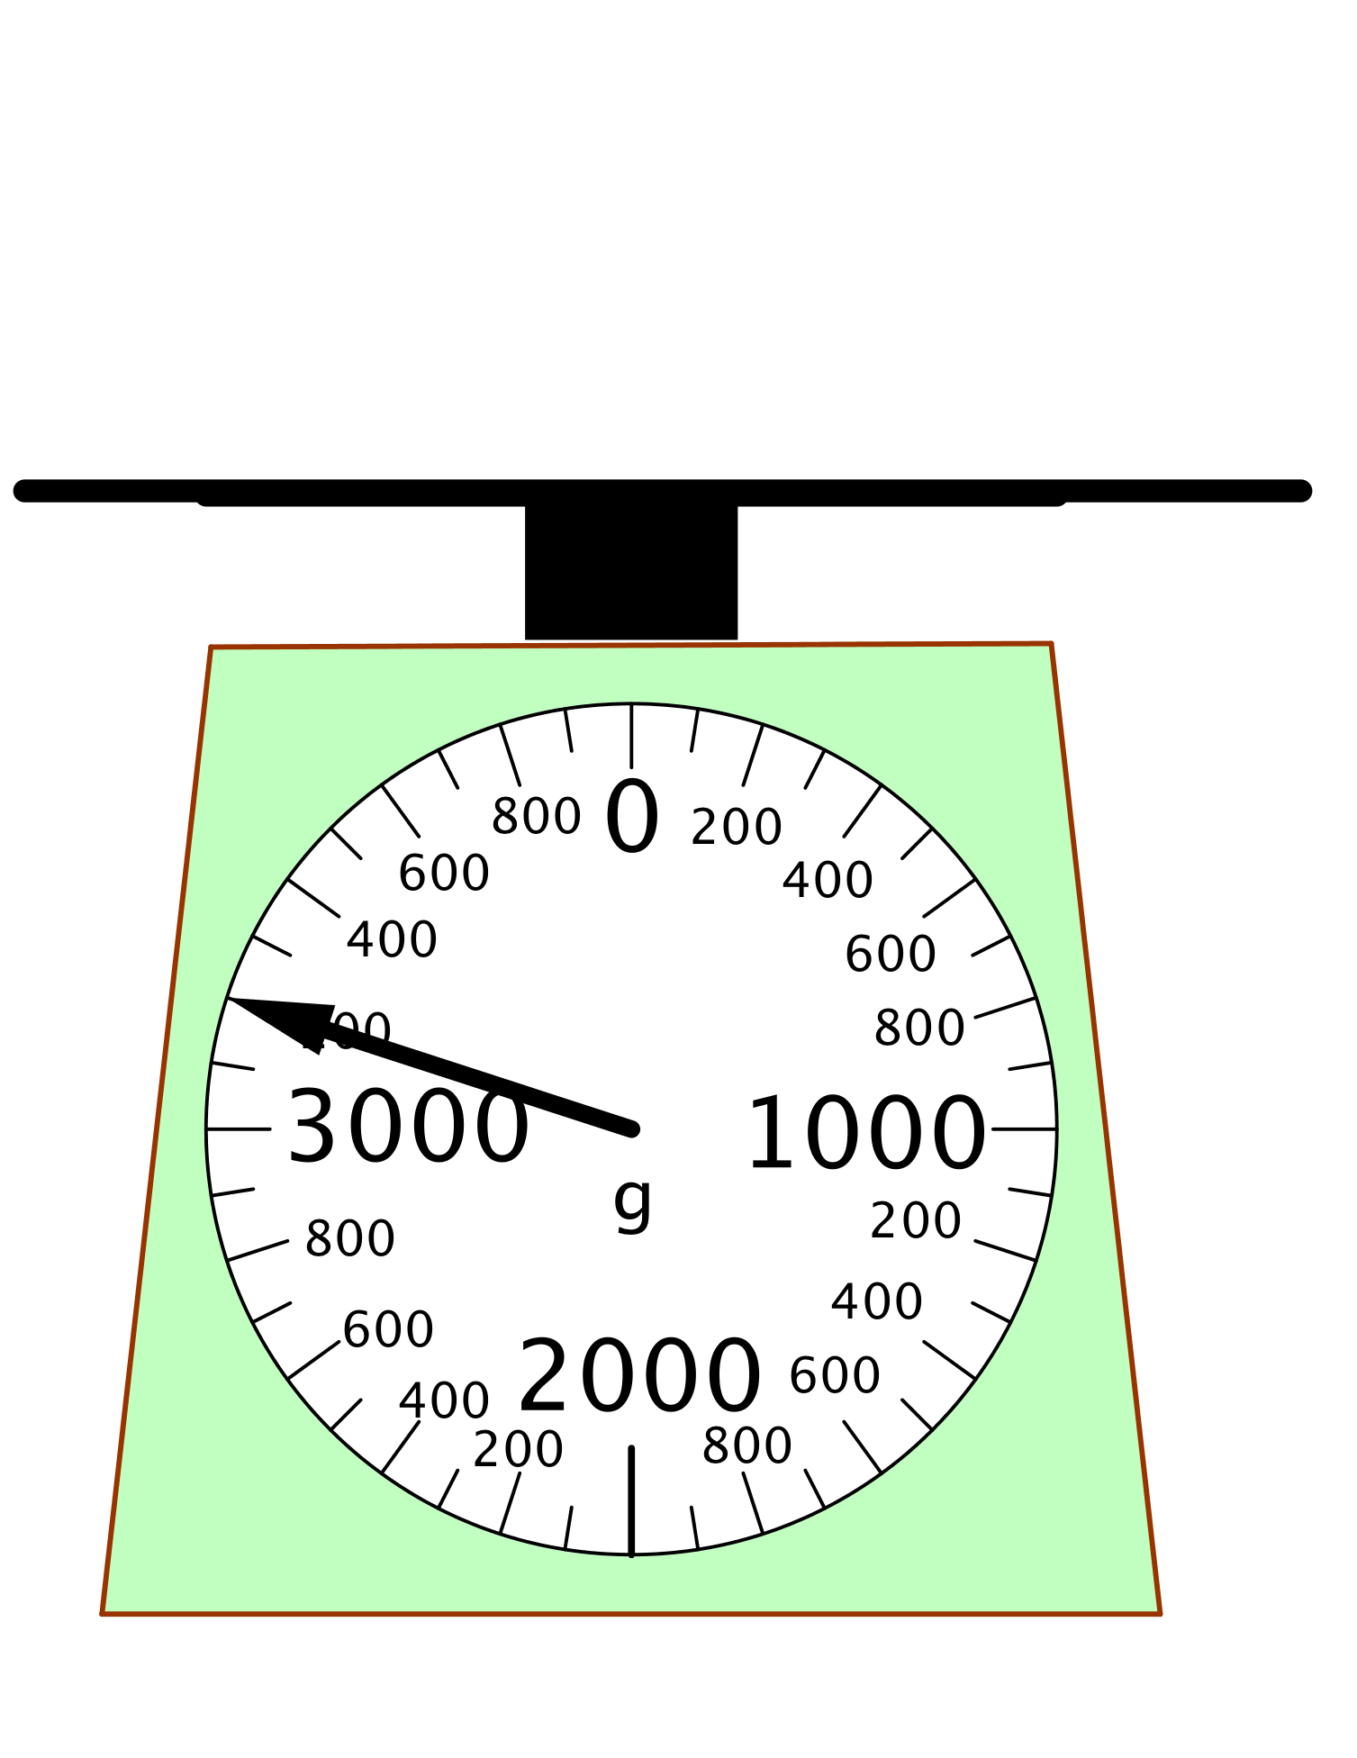
Gram only
Is it 200g?
3000g + 200g
= 3200g

Slide 7
Gram and kilogram
Is it 200g?
3kg +
200g
= 3 kg 200g

Slide 8
Convert
3kg 200g
= 3200g

Slide 9
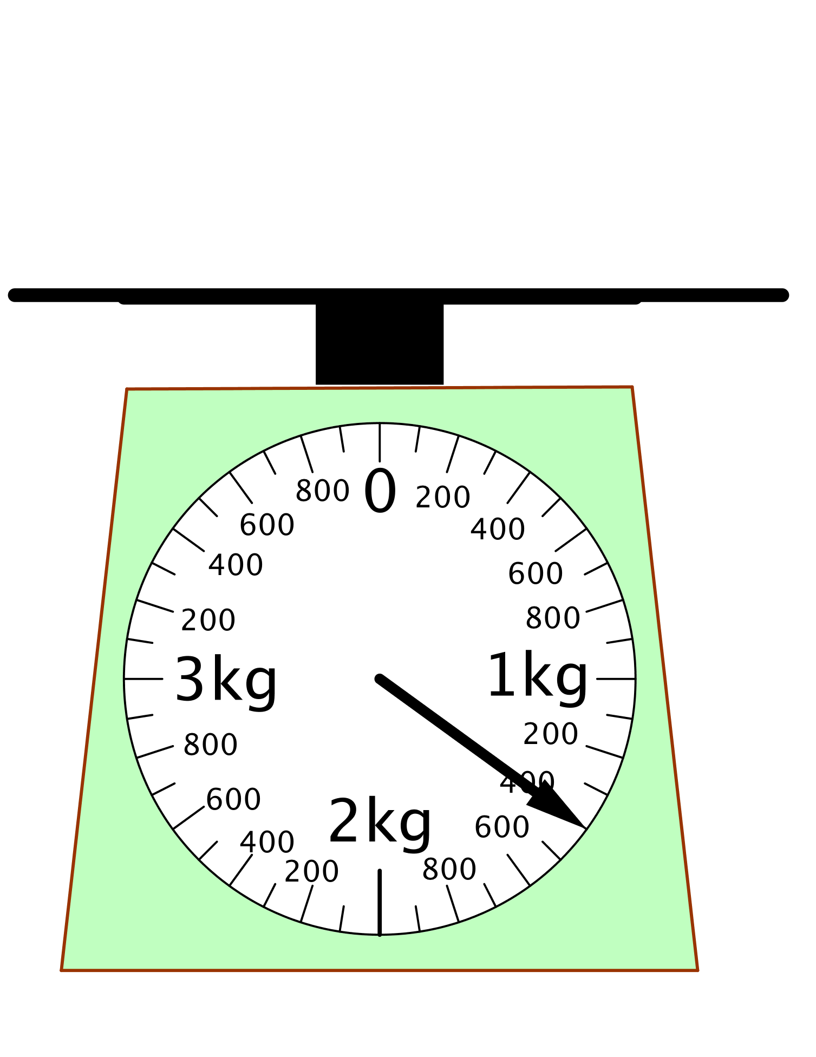
Gram and kilogram
Is it 400g?
1kg + 400g
= 1kg 400g

Slide 10
Gram only
Is it 400g?
1000g + 400g
= 1400g

Slide 11
Challenge
1000g
400g
1000g
If
1000g + 400g
= 1400g
Then
1000g + 40g
= ????
40g
1040g

Slide 12
Challenge
1000g
1000g
400g
If
1000g + 400g
= 1400g
and
1000g + 40g
= 1040g
40g
Then
1000g + 4g
=
1000g
1004g
4g

Slide 13
Convert (kg -> g)
1000
= 1kg + 400g
= 1000g + 400g
= 1400g
+
400
1400
= 1kg + 40g
= 1000g + 40g
= 1040g
1000
+
40
1040

Slide 14
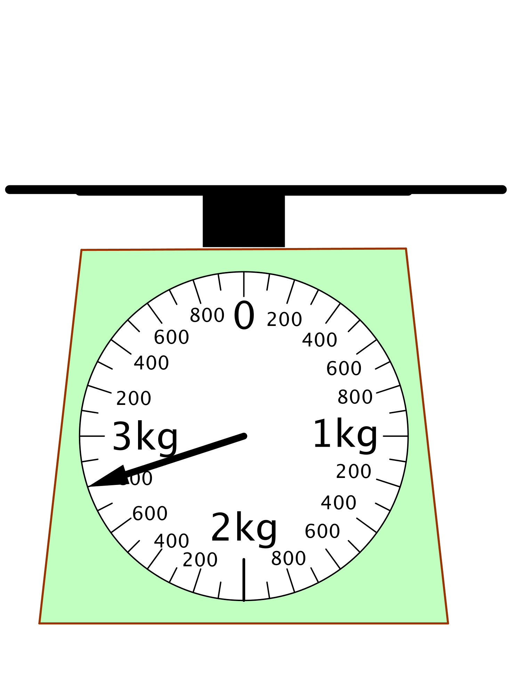
Convert (kg -> g)
1kg
1kg
800g
2kg + ? g
2kg + 800g
2000g + 800g
2800g
2kg 800g = 2800g

Slide 15
Convert (kg -> g)
2kg + 80g
2000g + 80g
2080g
1kg
1kg
80g
2kg 80g = 2080g

Slide 16
Convert (kg -> g)
2kg + 8g
2000g + 8g
2008g
1kg
1kg
8g
2kg 8g = 2008g

