Slide 1
Circles in Figure

Slide 2
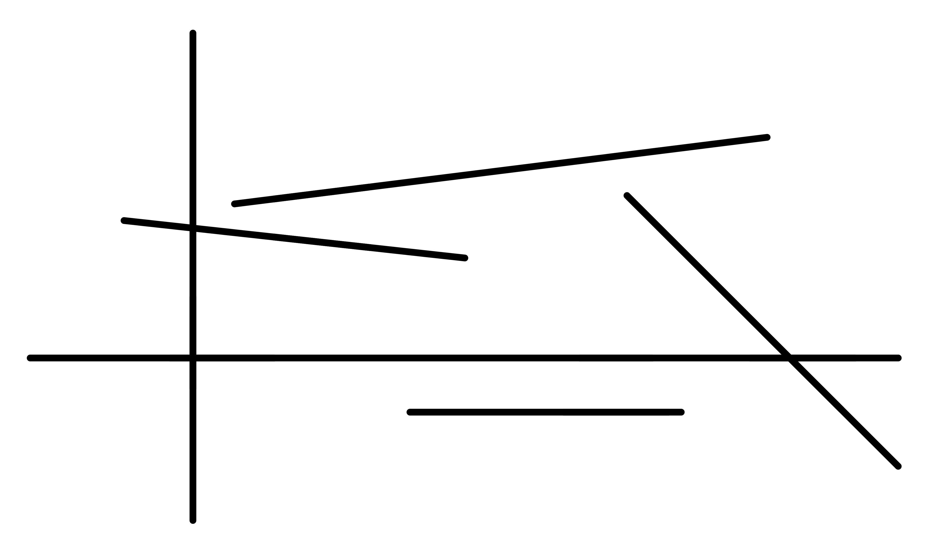
Question 1

Slide 3
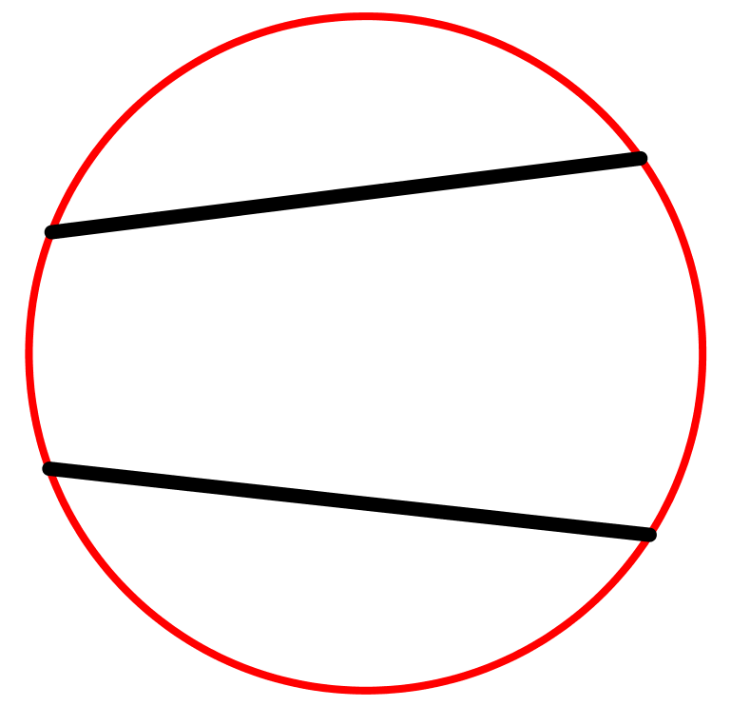
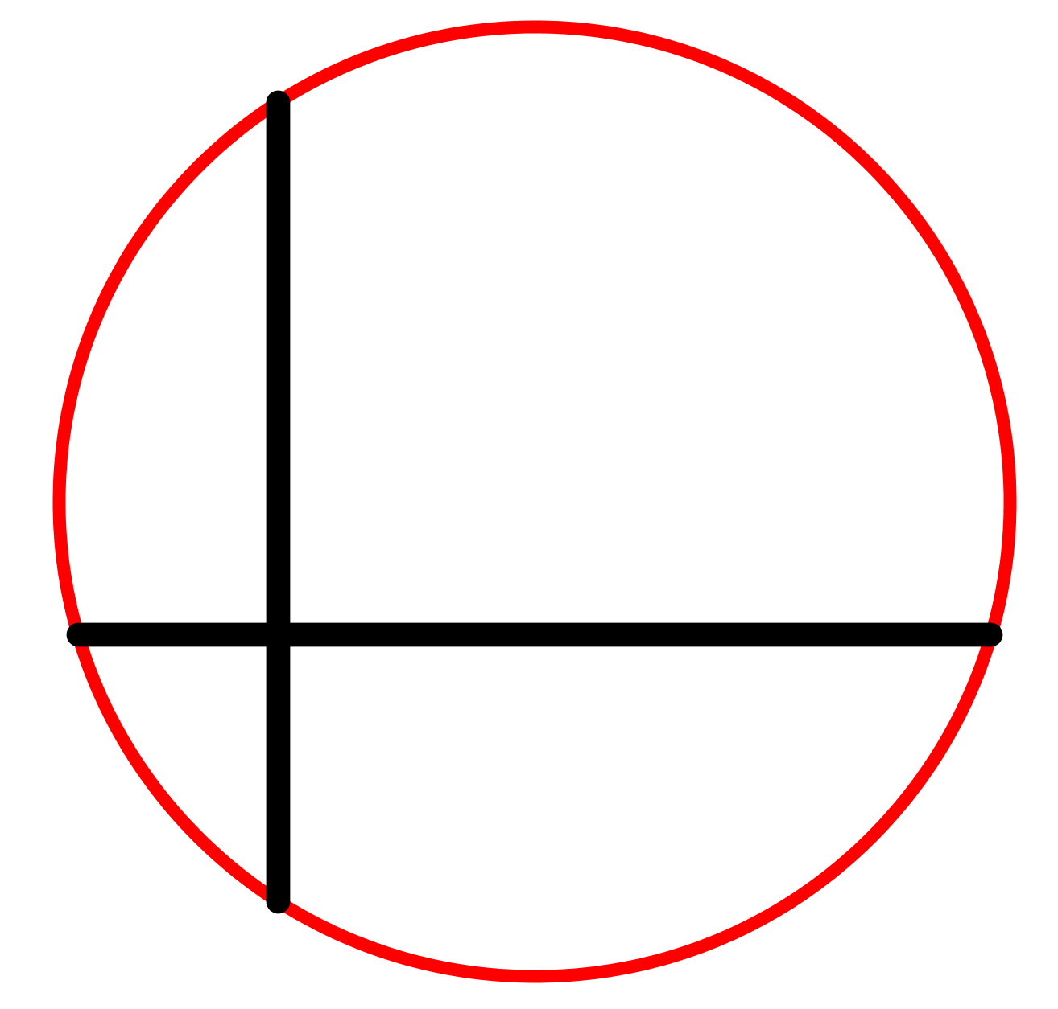
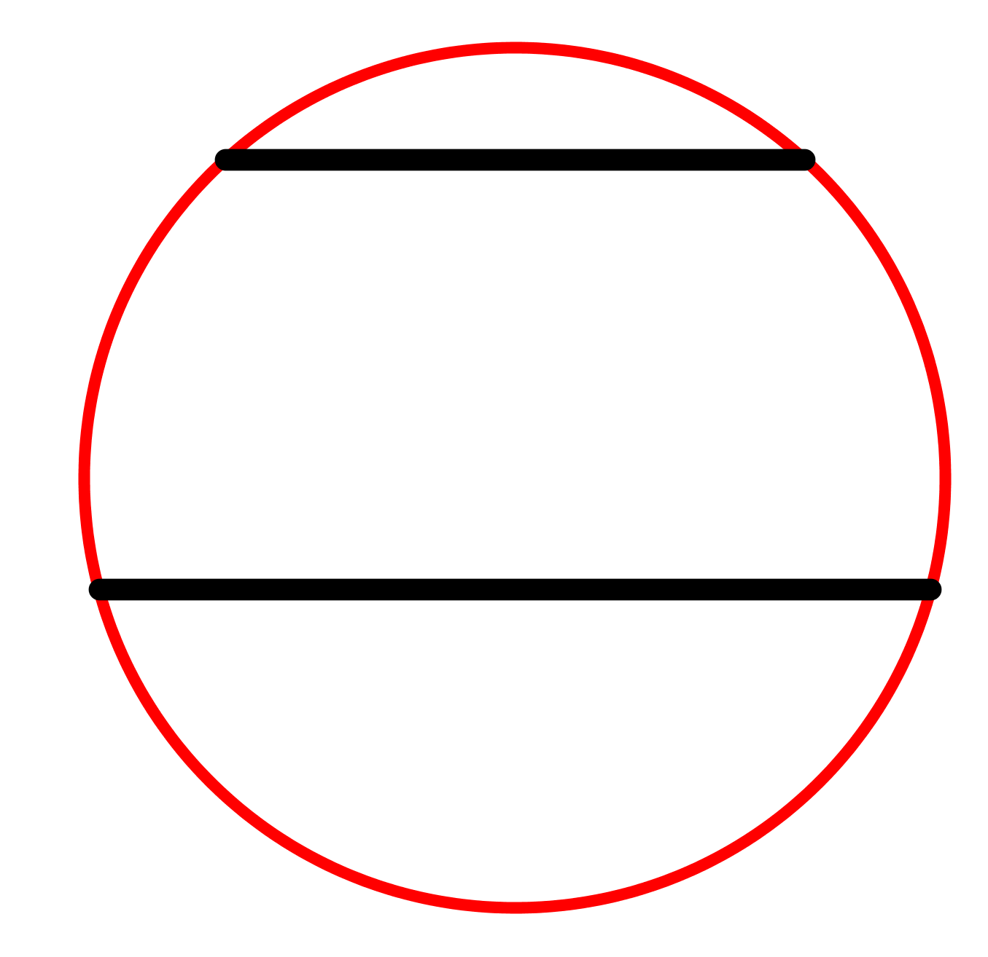
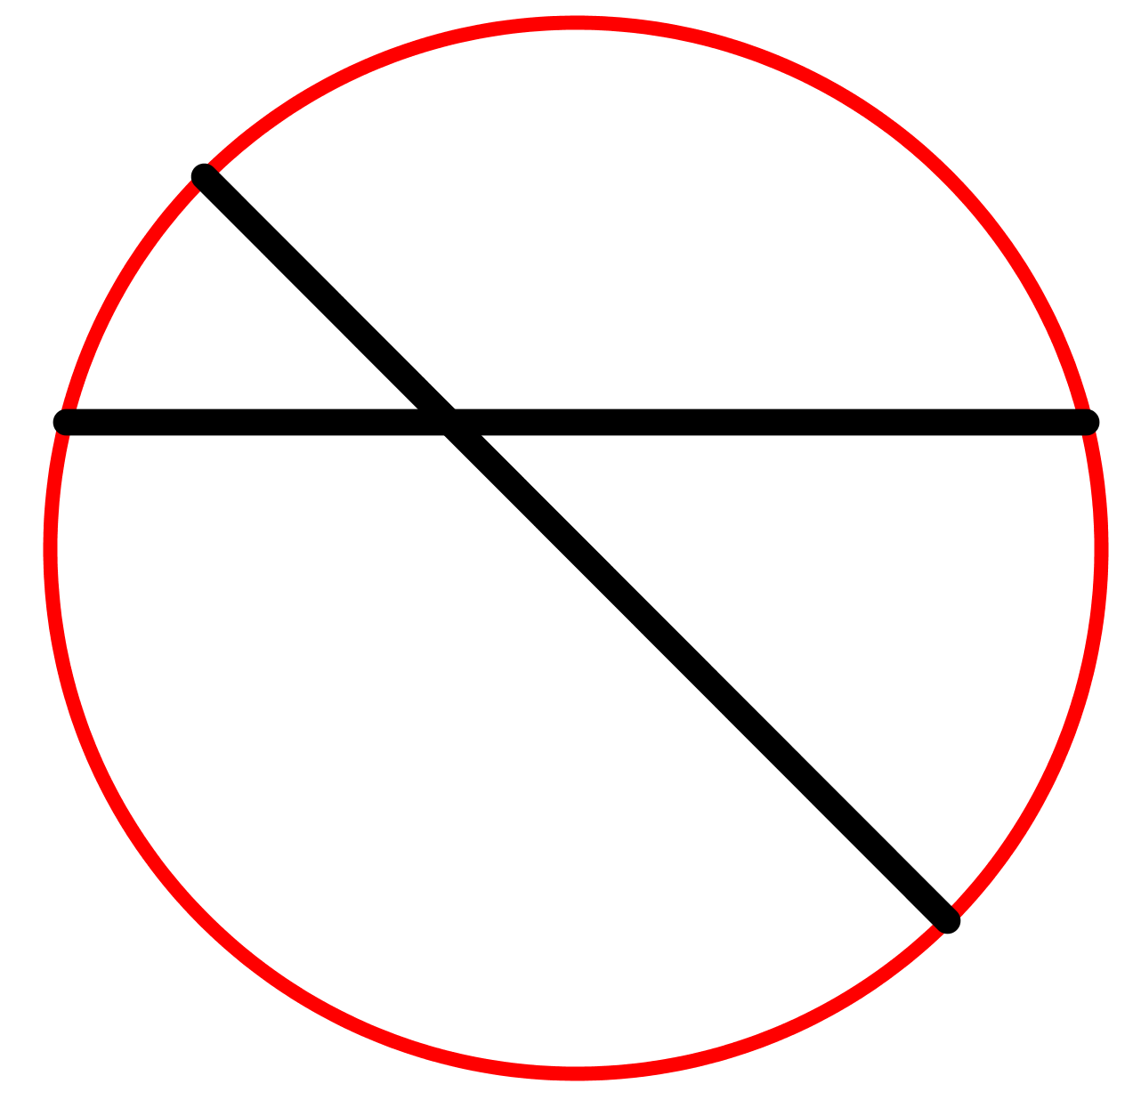
Picture 1
Picture 2
Picture 3
Picture 4

Slide 4
Question 1

Slide 5
Picture 1

Slide 6
Picture 1 (Hint)

Slide 7
Picture 2

Slide 8
Picture 2 (Hint)

Slide 9
Picture 3

Slide 10
Picture 3 (Hint)

Slide 11
Picture 4

Slide 12
Picture 4 (Hint)

Slide 13
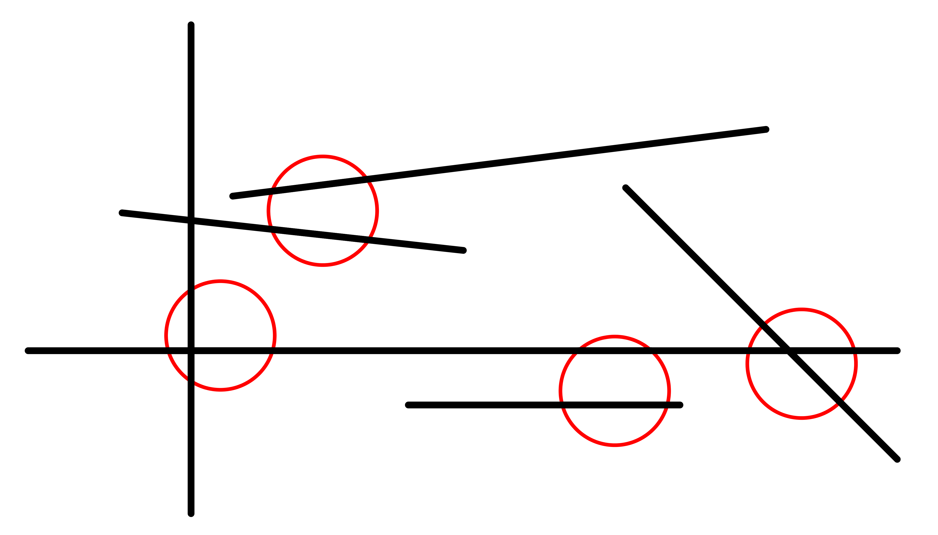
Question 1 (Answer)

Slide 14
Question 2

Slide 15
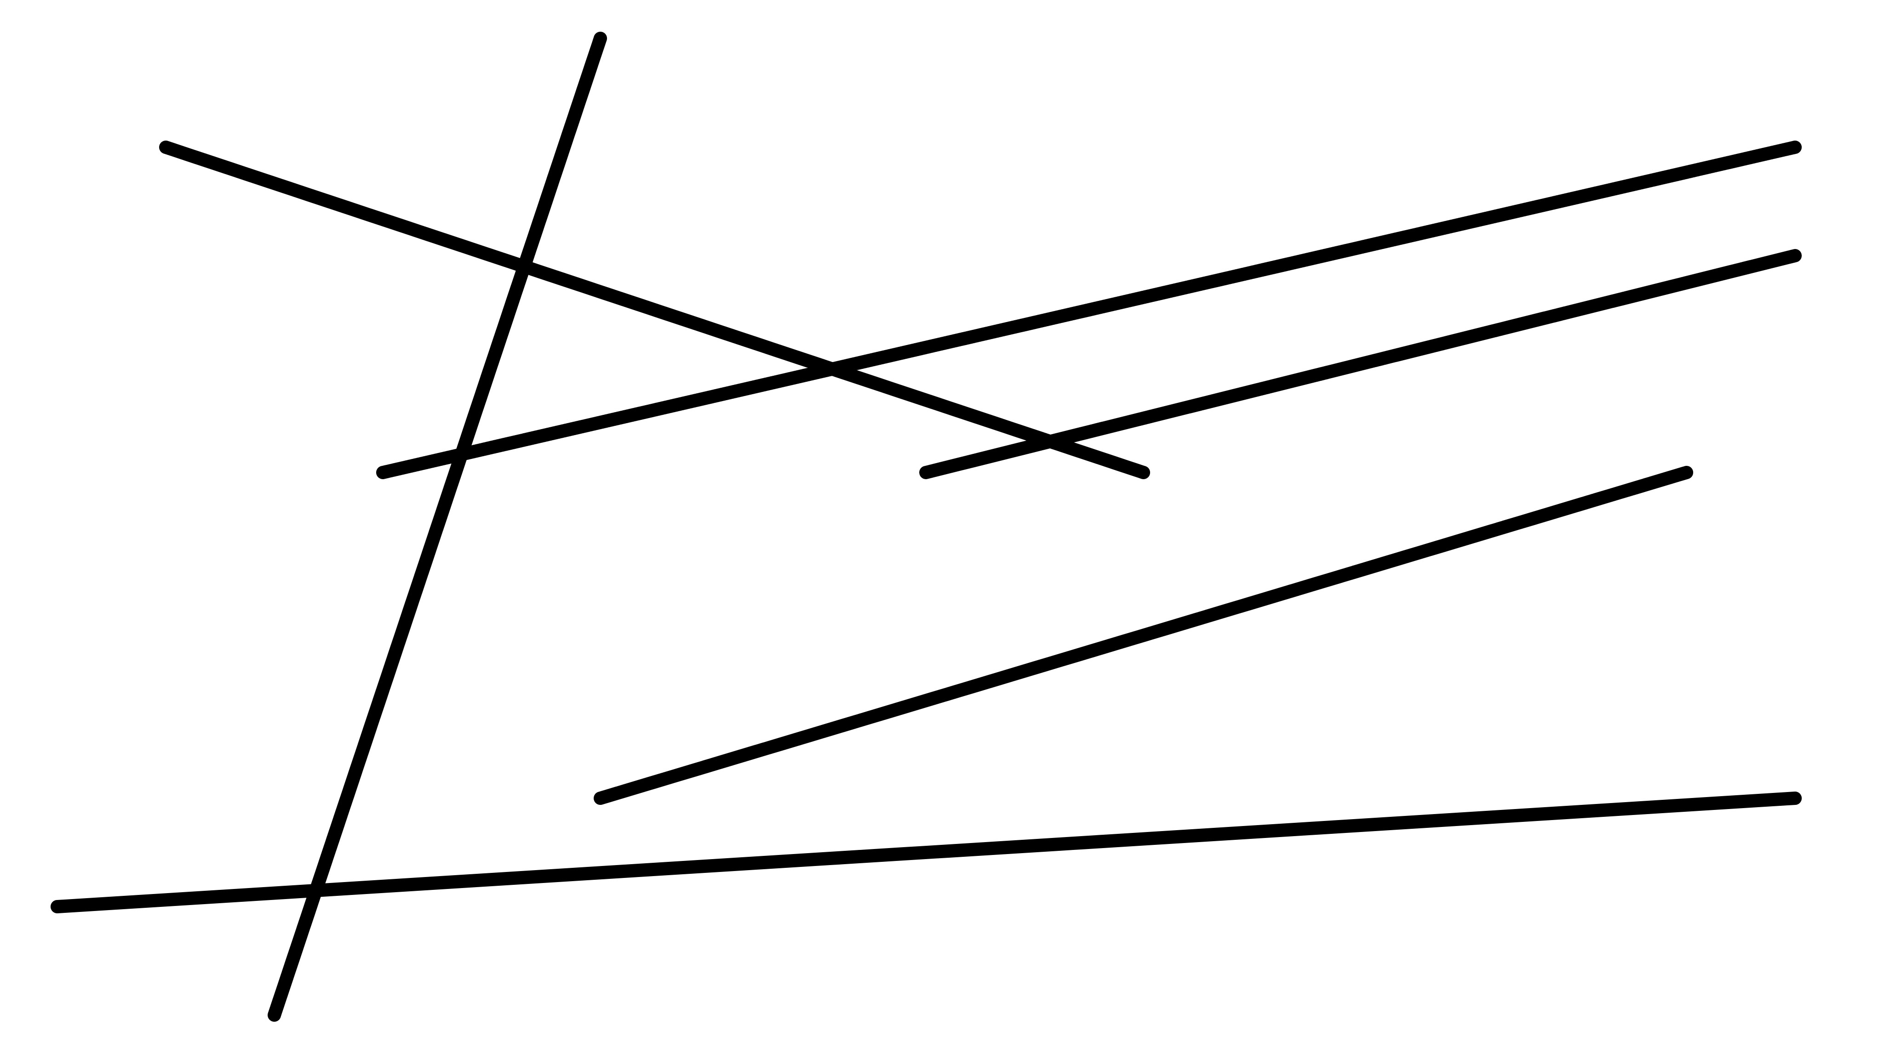
Question 2

Slide 16
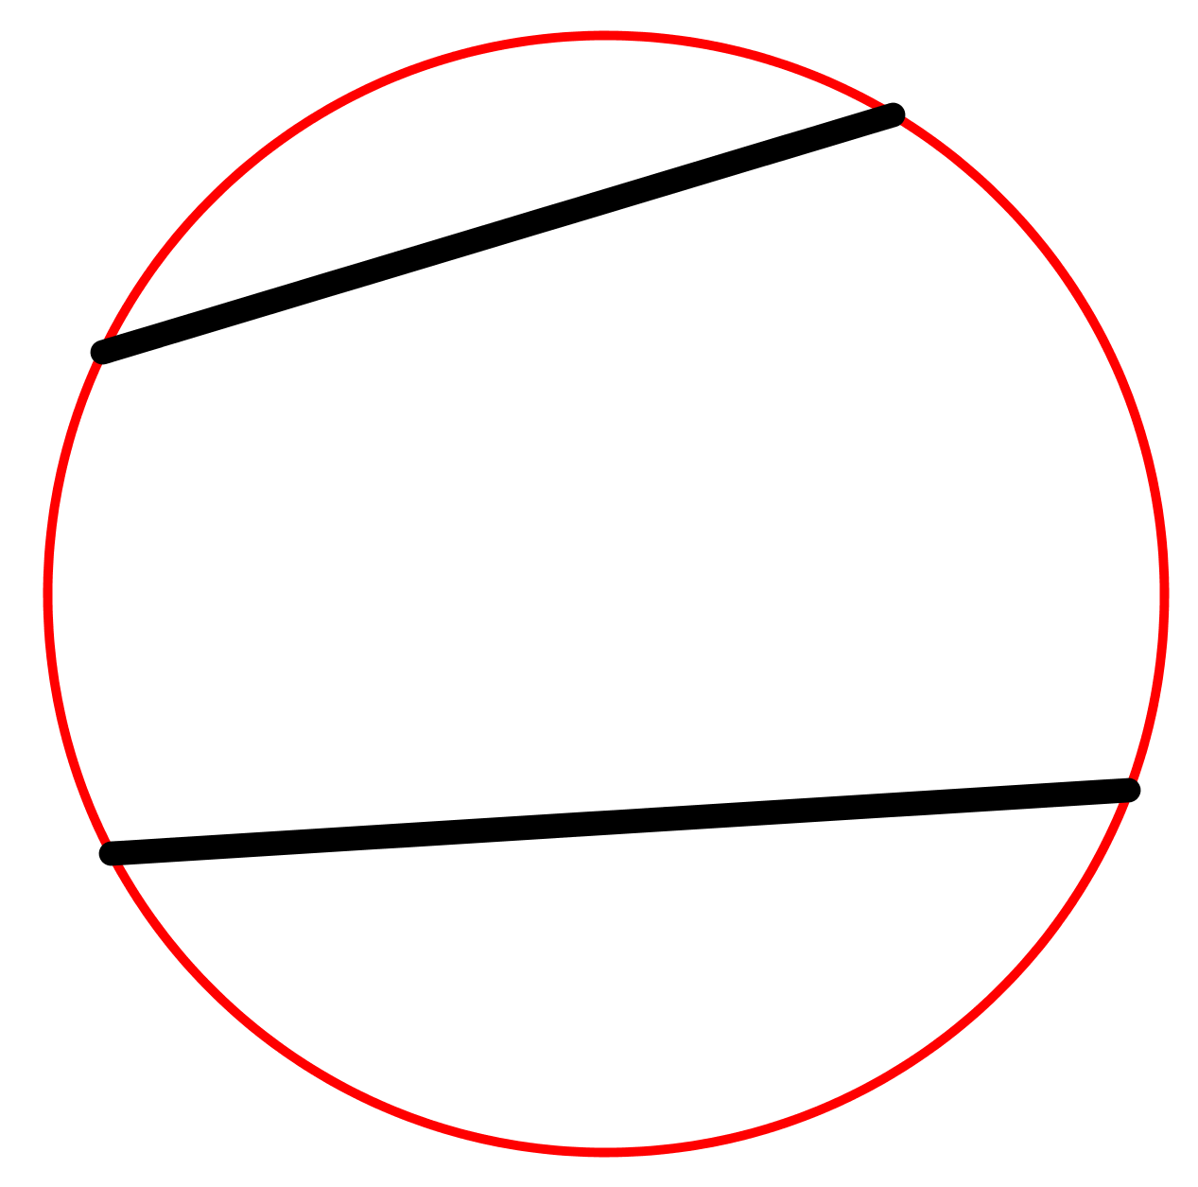
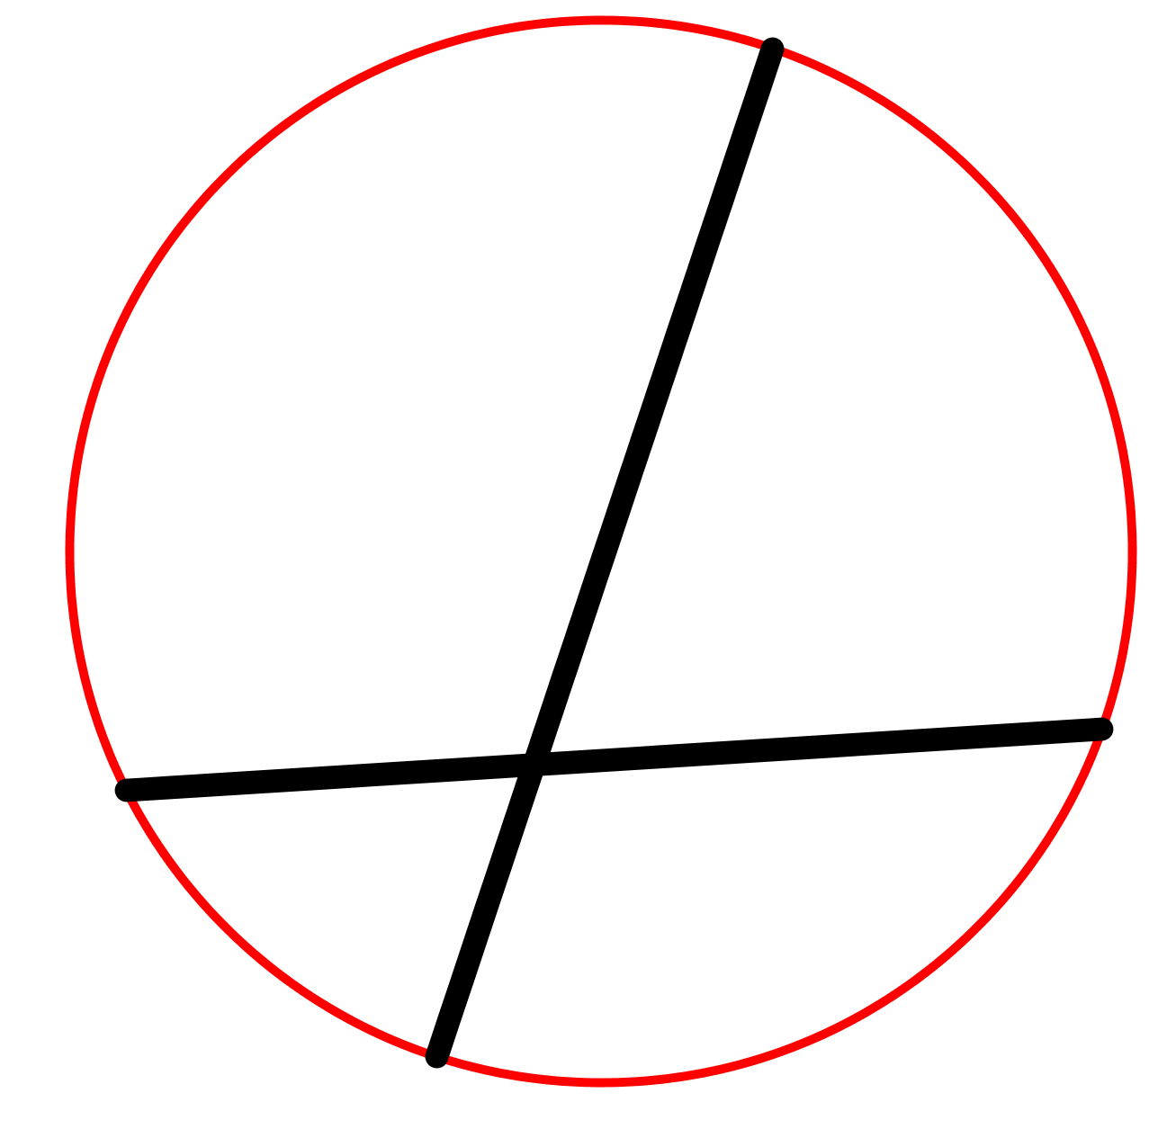
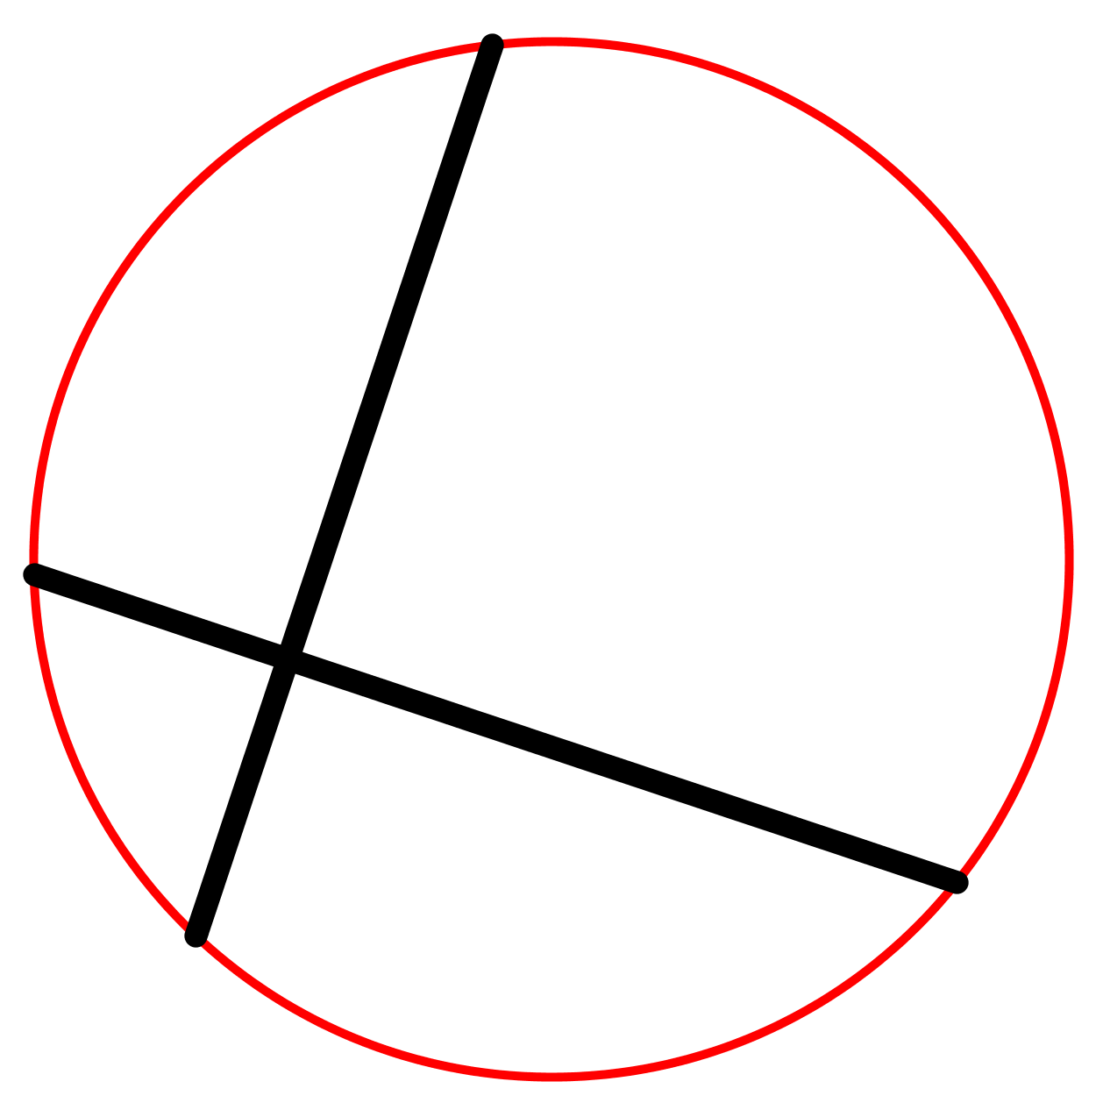
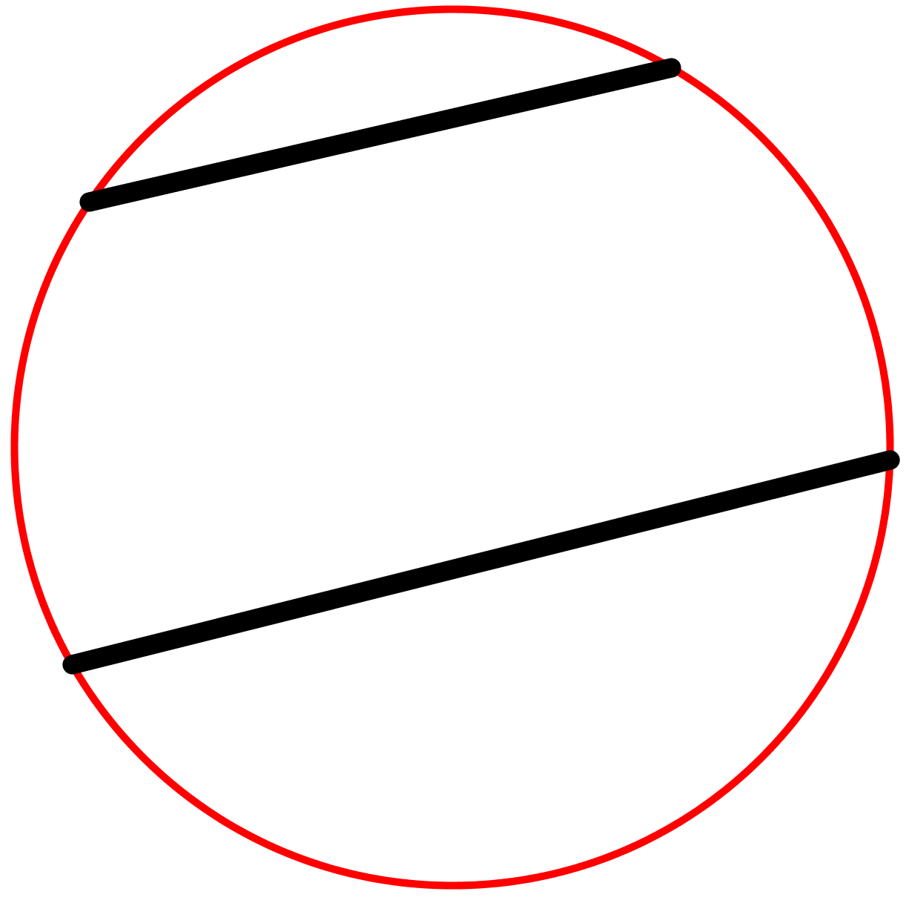
Picture 1
Picture 2
Picture 3
Picture 4

Slide 17
Question 2

Slide 18
Picture 1

Slide 19
Picture 1 (Hint)

Slide 20
Picture 2

Slide 21
Picture 2 (Hint)

Slide 22
Picture 3

Slide 23
Picture 3 (Hint)

Slide 24
Picture 4

Slide 25
Picture 4 (Hint)

Slide 26
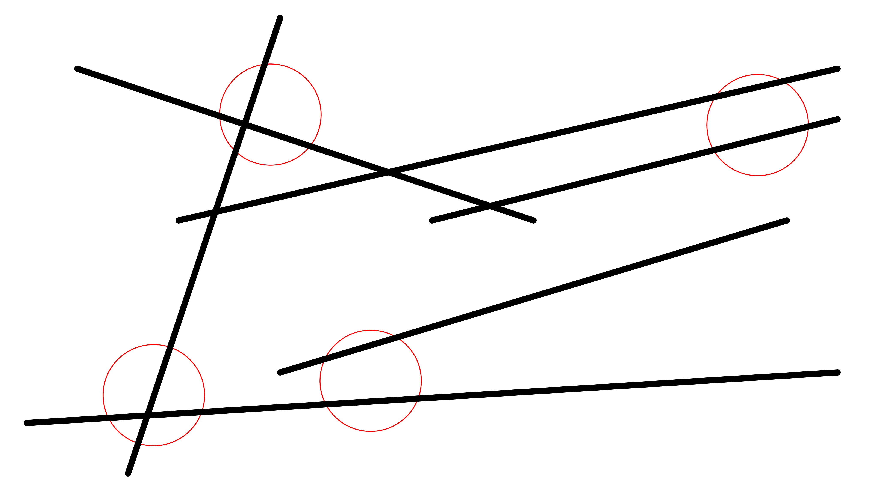
Question 2 (answer)

Slide 27
Question 3

Slide 28
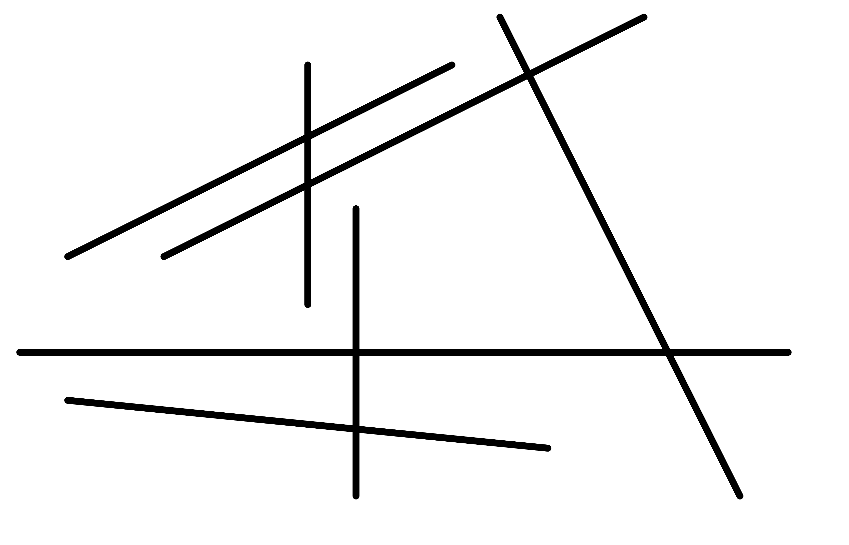
Question 3

Slide 29
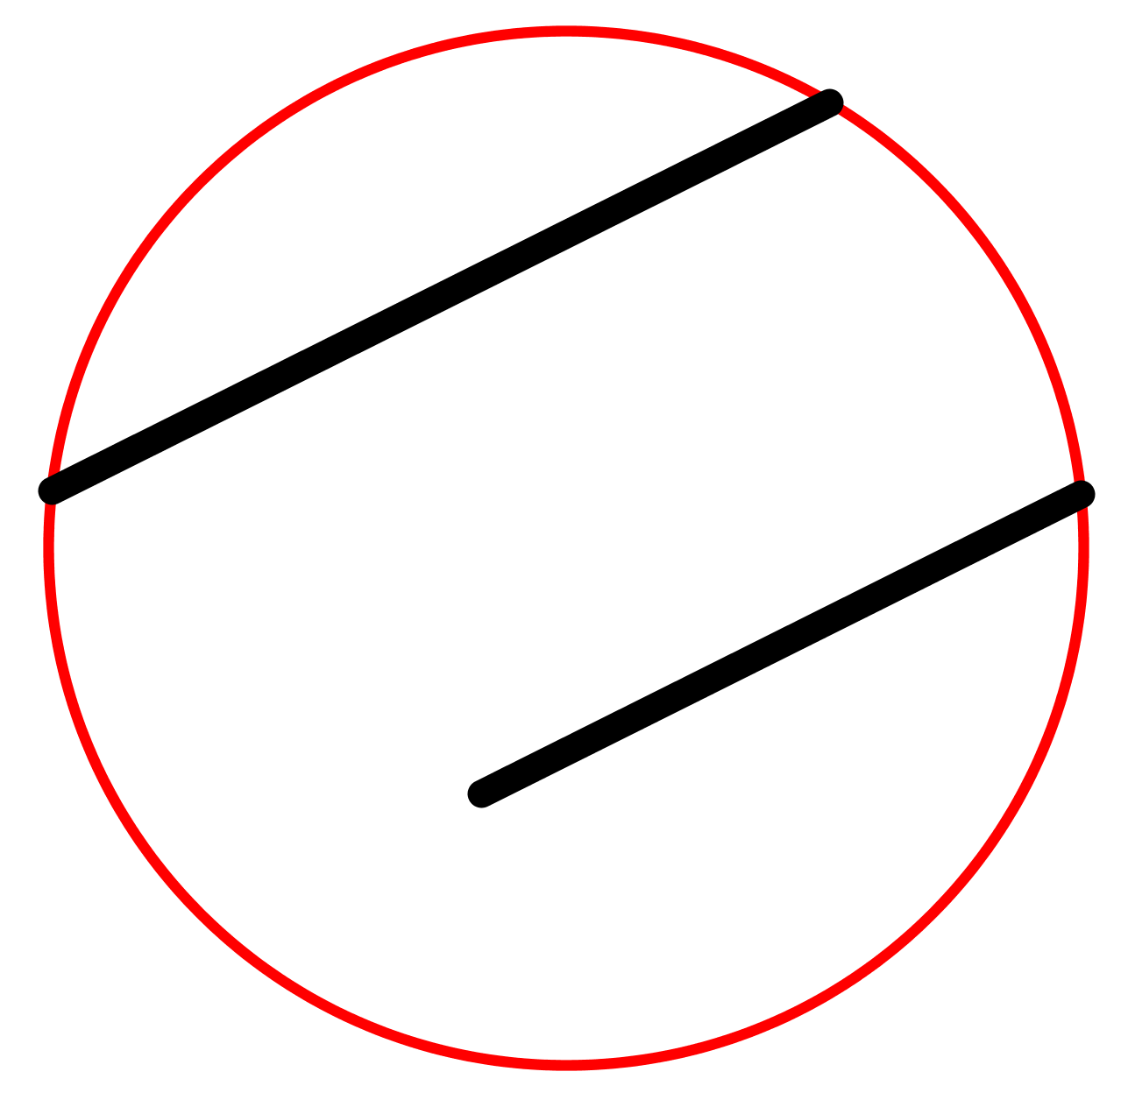
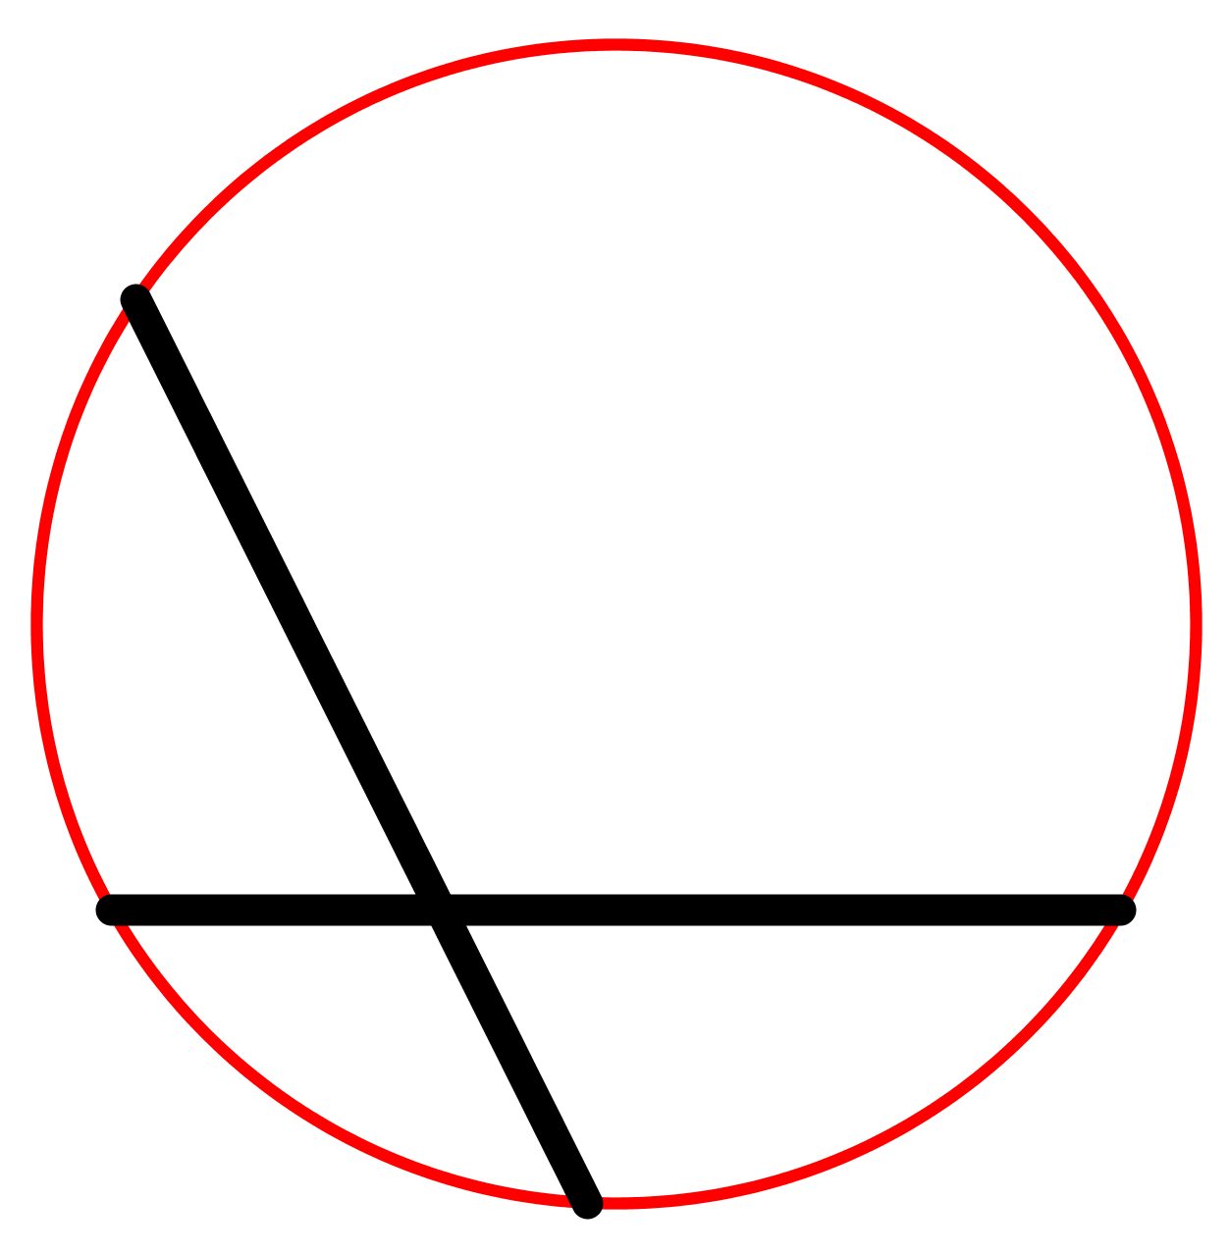
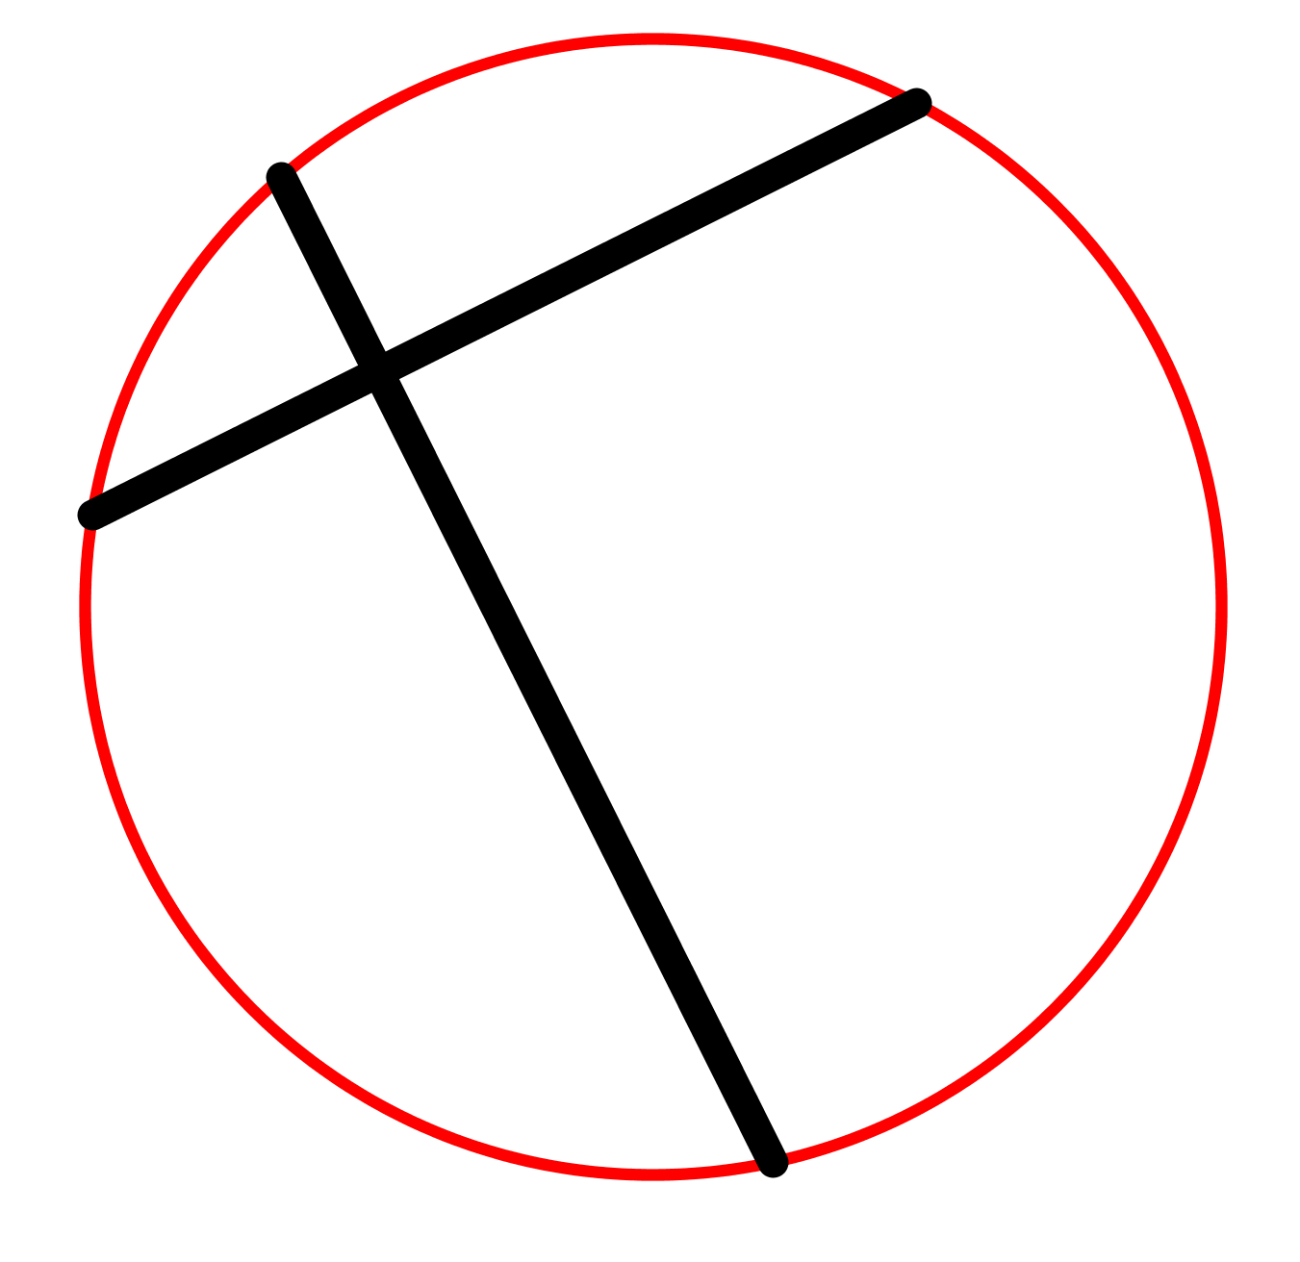
Picture 1
Picture 2
Picture 3
Picture 4

Slide 30
Question 3

Slide 31
Picture 1

Slide 32
Picture 1 (Hint)

Slide 33
Picture 2

Slide 34
Picture 2 (Hint)

Slide 35
Picture 3

Slide 36
Picture 3 (Hint)

Slide 37
Picture 4

Slide 38
Picture 4 (Hint)

Slide 39
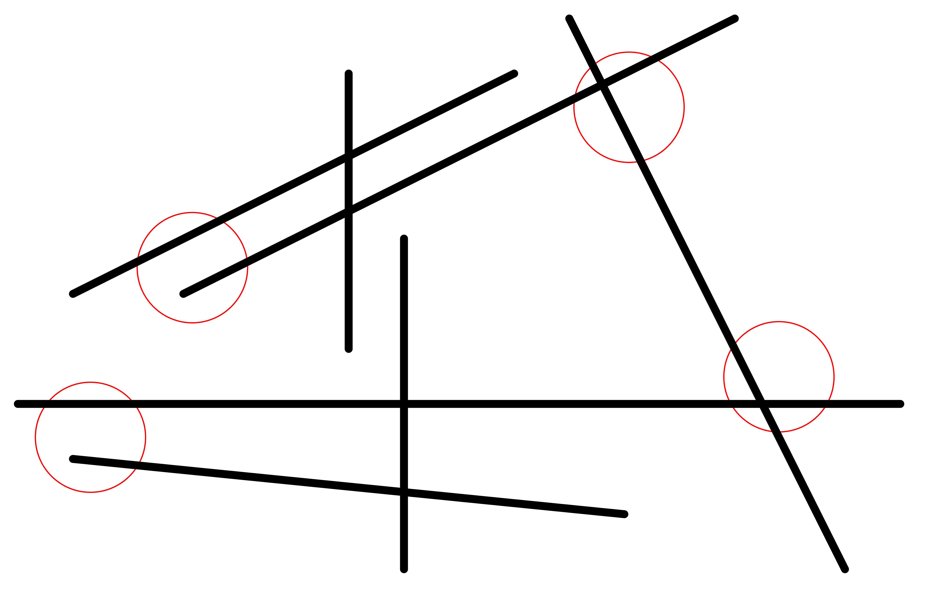
Question 3 (answer)

