Slide 1
How to Draw on Grid?

Slide 2
Question 1: How to draw?

Slide 3
1st Line

Slide 4
1st Line
Find another point
Find one point

Slide 5
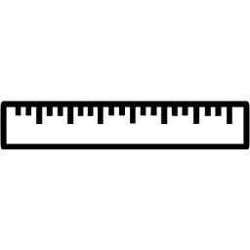
1st Line
Find another point
Find one point

Slide 6
1st Line
1 line completed!

Slide 7
2nd Line

Slide 8
2nd Line
From here
go down 1 square
Point 1

Slide 9
2nd Line
Point 2
Point 1

Slide 10
2nd Line
Point 2
Point 1

Slide 11
2nd Line
2 lines completed!

Slide 12
3rd Line

Slide 13
3rd Line
From here
go down 2 squares
Point 1

Slide 14
3rd Line
Use a ruler join 2 points

Slide 15
3rd Line
3 lines completed !

Slide 16
The Last Line

Slide 17
The Last Line
Can you find me?
Point 2
Point 1

Slide 18
The Last Line
Use a ruler to join the 2 points

Slide 19
The Last Line
DONE！

Slide 20
Question 2

Slide 21
Question 3: How?

Slide 22
1st Line
Find Point 1
Find Point 2

Slide 23
1st Line

Slide 24
1st Line

Slide 25
2nd Line
Find Point 1
Find Point 2

Slide 26
2nd Line

Slide 27
3rd Line
Find Point 1
Find Point 2

Slide 28
3rd Line

Slide 29
3rd Line

Slide 30
The Last Line
Find Point 1
Find Point 2

Slide 31
The Last Line

Slide 32
The Last Line
DONE！

