Slide 1
Common Factor and Highest Common Factor

Slide 2
My Lawn
no fences here
12 m
wall
12 m
wall
no fences here

Slide 3
Fence？

Slide 4
Different lengths of fence
4 m
4
12 m
1
6
2
8
3
9
4
12
5

Slide 5
What is the length of fence to choose？
4
4
4
12 m
4 m fence can fit the side, why?
12 ÷ 4 = 3
No remainder
We can say: 4 is a factor of 12

Slide 6
Actually, this is my lawn.
no fences here
12 m
wall
wall
18 m
no fences here

Slide 7
What is the length of fence to choose？
13
Someone suggests fences of 13m long.
Is it OK？
4
1
2
3
12
9
8
6
5

Slide 8
Someone suggests fences of 1 m long.
This is too tiring!
Use a longer fence!
1
1
1
1
1
1
1
1
1
1
1
1
Fred
1
1
1
1
1
1
1
1
1
1
1
1
1
1
1
1
1
1

Slide 9
Fred wants to use fences of 5m long.
5
5
12 m
Why can’t it fit?
18 m

Slide 10
Why can’t we use 5 m fences to fit 12 m?
12 ÷ 5 = 2 .. 2
Used 2 fences
Remainder is 2.
It leaves a 2m gap.

Slide 11
Kay suggests 4 m fences
12 ÷ 4 = 3
No remainder
4
4
4
12 m
4
4
4
4
18 m
Why can’t it fit?

Slide 12
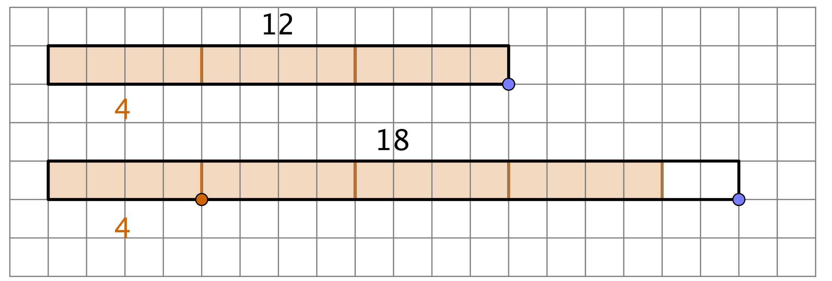
Why？
Use 4 m fences.
Can fit the12 m side.
But not the 18 m side.

Slide 13
Why？
12 ÷ 4 = 3
Uses 3 fences
No remainder
18 ÷ 4 = 4 .. 2
Uses 4 fences
2 m remains, not fit

Slide 14
Kiki says: 12 and 18 are even numbers
Use 2 m!
2
2
2
2
2
2
2
2
2
2
2
2
2
2
2

Slide 15
12 and 18
12 is even, so it is divisible by 2 （12 ÷ 2 has no remainder）
So, 2 is a factor of 12.
18 is also even, so it is also divisible by 2 （18 ÷ 2 has no remainder）
So, 2 is a factor of 18.

Slide 16
12 and 18…
12 and 18 are both divisible by 2
So, 2 is a factor of 12.
and also a factor of 18.
2 is a common factor of 12 and 18.
2
2
2
2
2
2
Both have the same factor.
2
2
2
2
2
2
2
2
2

Slide 17
Fred says
It takes a very long time!
Use a longer fence!
2
2
2
2
2
2
2
2
2
2
2
2
2
2
2

Slide 18
Let’s use the 3 m fences
Guess if it fits both sides? Why?

Slide 19
Let’s use the 3 m fences
It takes a very long time!
Use a longer fence!
12 is divisible by 3 （No remainder）
18 is also divisible by 3 （ No remainder ）
So, 3 is a common factor of 12 and 18

Slide 20
We have tried 1, 2, 3, 4, 5 m
1 m、2 m、3 m fences can fit
Because they are common factors of 12 and 18
4 is a factor of 12, but not a factor of 18
5 is not a factor of 12 and is not a factor of 18

Slide 21
Let’s use the 6 m fences!
Guess if it fits both sides? Why?

Slide 22
Let’s use the 6 m fences!
Can it be even faster ?
6 is a factor of 12 (12 is divisible by 6)
6 is also a factor of 18 (18 is also divisible by 6)
So, 6 is a common factor of 12 and 18.

Slide 23
Can we use even longer fences？

Slide 24
Can we use even longer fences？
7 is not a factor of 12, and not a factor of 18

Slide 25
Can we use even longer fences？

Slide 26
Can we use even longer fences？
8 is not a factor of 12, and not a factor of 18

Slide 27
Can we use even longer fences？

Slide 28
Can we use even longer fences？
9 is a factor of 18
But 9 is not a factor of 12

Slide 29
Can we use even longer fences？
10 is not a factor of 12, and not a factor of 18

Slide 30
Can we use even longer fences？
11 is not a factor of 12, and not a factor of 18

Slide 31
Can we use even longer fences？
12 is a factor of 12, But not a factor of 18

Slide 32
Should we try 13, 14, 15, 16, 17, 18 m fences？
13
12 m
18 m

Slide 33
The longest fence that fits both sides.
Ok, I will choose the 6 m fences.
That is the quickest way.

Slide 34
Let’s fence!
12 m
6
6
6
6
6
18 m

Slide 35
Summary
Factors of 12 are 1, 2, 3, 4, 6, 12
Factors of 18 are 1, 2, 3, 6, 9, 18
Common factors are 1, 2, 3, 6
Among them, the Highest common factor is 6
6 is the Highest common factor (H.C.F.) of 12 and 18

