Slide 1
Angles of a Polygon

Slide 2
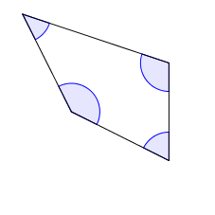
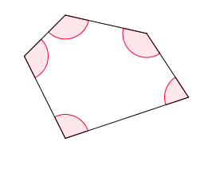
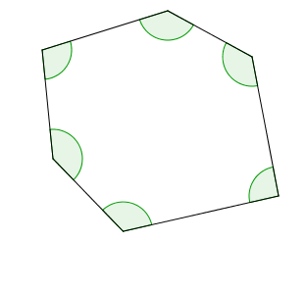
Interior angles of a polygon
Angles inside a polygon are called interior angles of a polygon. The interior angles of some convex polygons are shown below.
Quadrilateral
Pentagon
Hexagon
All interior angles of a convex polygon are less than 180°.

Slide 3
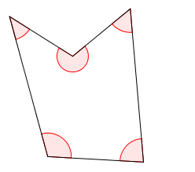
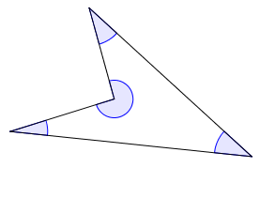
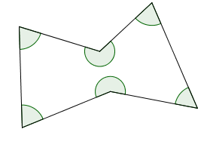
Interior angles of a polygon
The interior angles of some concave polygons are shown below.
Quadrilateral
Pentagon
Hexagon
In a concave polygon, at least one interior angle is greater than 180°.

Slide 4
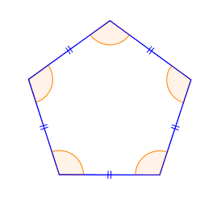
Interior angles of a regular polygon
Regular polygons are polygons which are equilateral (equal sides) and equiangular (equal angles).
e.g.
Therefore, all interior angles of a regular polygon are equal.
Regular pentagon

Slide 5
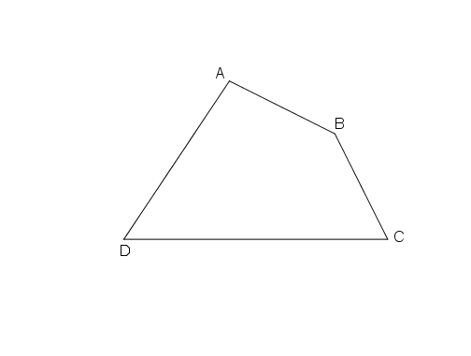
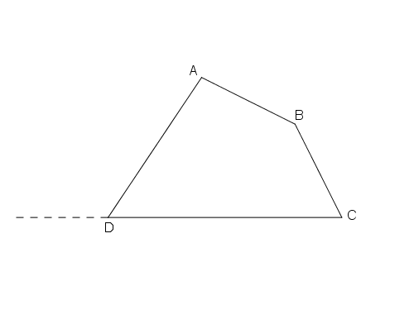
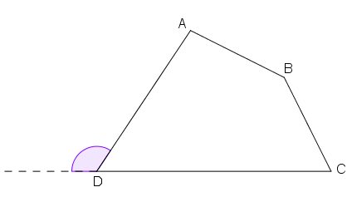
Exterior angles of a polygon
If one side of a convex polygon is produced,
the angle between the line produced and the adjacent side is called an exterior angle of a polygon.
Quadrilateral

Slide 6
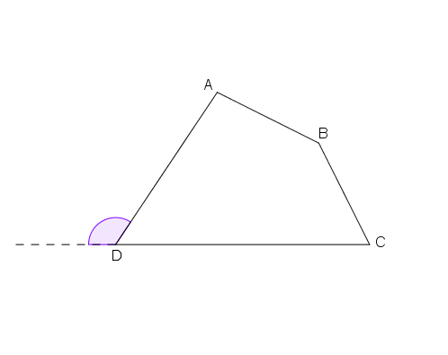
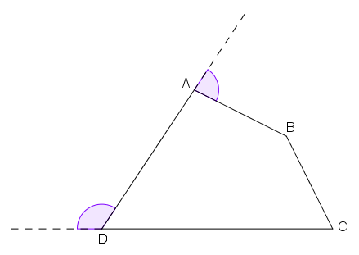
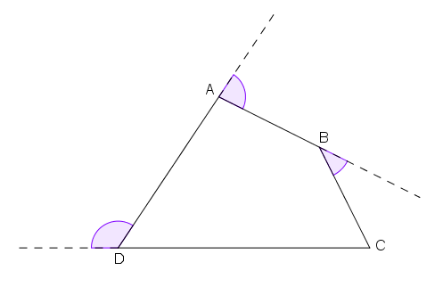
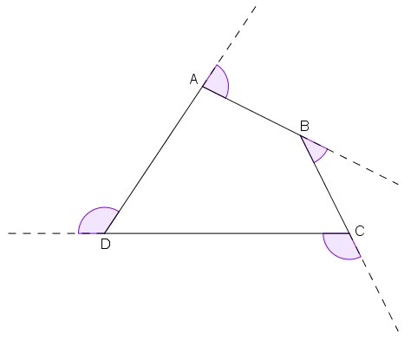
Exterior angles of a polygon
Similarly, these are the exterior angles of a convex polygon.
Quadrilateral

Slide 7
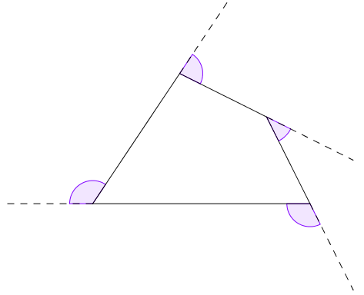
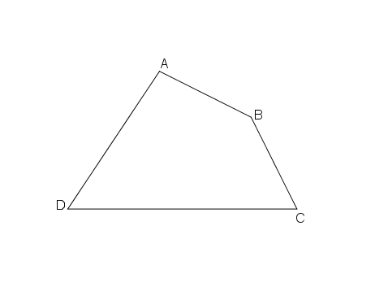
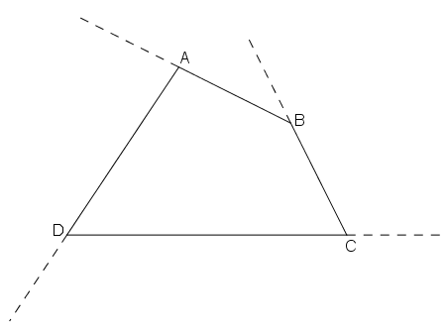
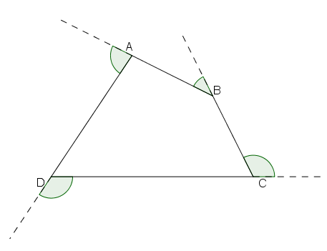
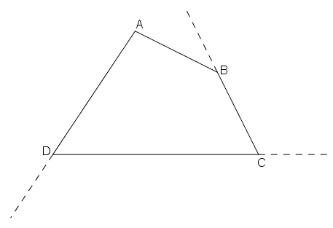
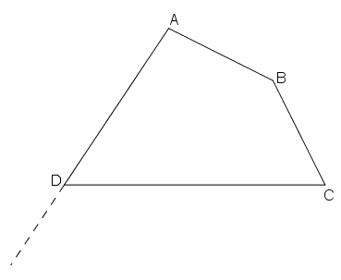
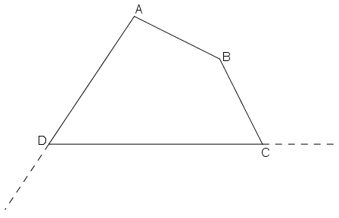
Exterior angles of a polygon
Let’s produce the sides in another way.
Are the angles formed the exterior angles of a convex polygon?
They are also the exterior angles of a convex polygon.
Quadrilateral

Slide 8
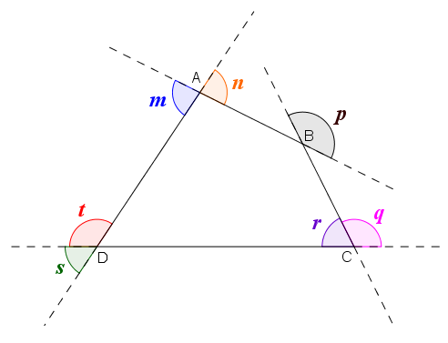
Exterior angles of a polygon
Which of the following angles are the exterior angles of this quadrilateral?
*not lying on any side of the quadrilateral
2.
1.
3.
7.
5.
4.
6.
*not lying on any side of the quadrilateral
*not lying on any produced side of the quadrilateral

Slide 9
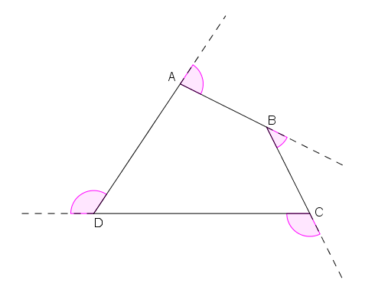
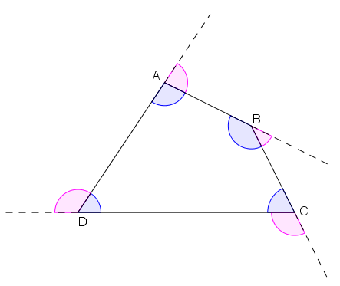
Exterior angles of a polygon
Each exterior angle of a polygon and its corresponding interior angle are adjacent angles on a straight line.
Exterior angles
Interior angles
Exterior angles
Quadrilateral

Slide 10
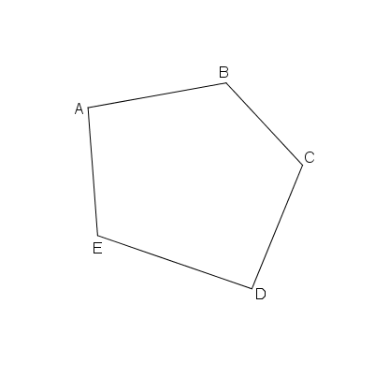
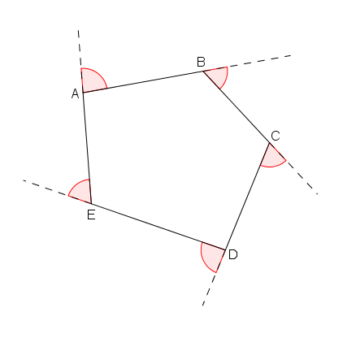
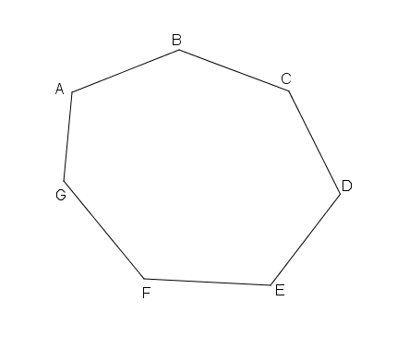
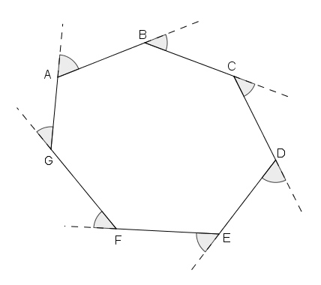
Exterior angles of a polygon
Let’s take a look at the exterior angles of different polygons.
Pentagon
Heptagon

Slide 11
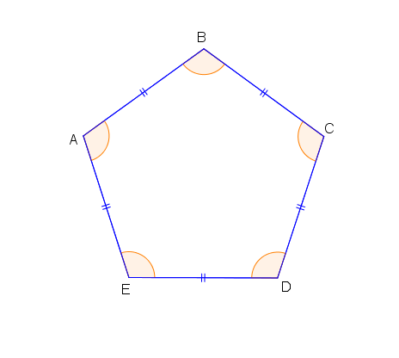
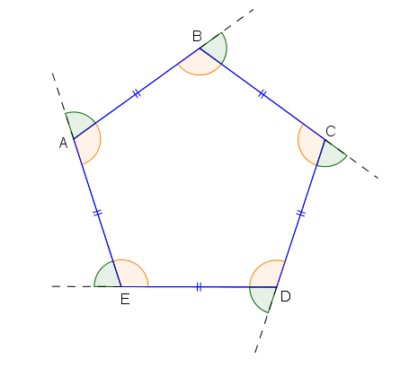
Exterior angles of a regular polygon
$∵$ All interior angles of a regular polygon are equal.
Also, each exterior angle and its corresponding interior angle are adjacent angles on a straight line.
$∴$ All exterior angles of a regular polygon are equal.
Regular pentagon

Slide 12
~The End~

