Slide 1
Recognition of corresponding angles, alternate angles and interior angles on the same side of the transversal

Slide 2
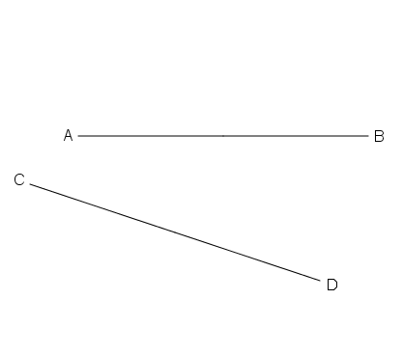
Transversal
P
Q
There are two straight lines AB and CD in the figure.
When the lines AB and CD are cut by another line PQ,
PQ is called a transversal of AB and CD.

Slide 3
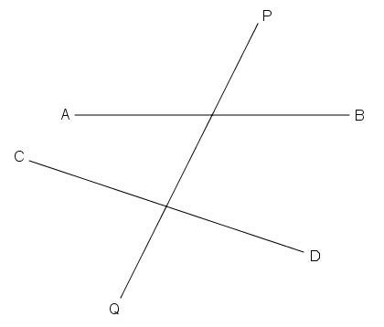
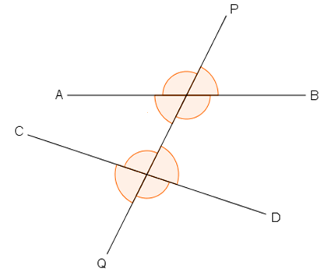
Angles formed by a Transversal
a
b
d
c
h
i
k
j
When two lines AB and CD are cut by the transversal PQ,
8 angles will be formed at the two intersections.
These angles are named according to their relative positions.

Slide 4
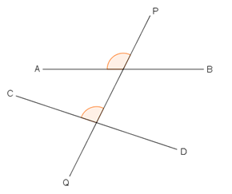
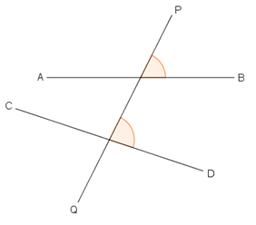
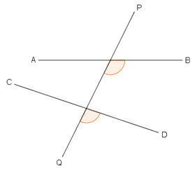
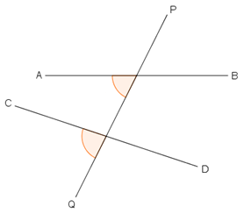
Corresponding angles
a
b
h
i
c
d
k
j
The angles in each pair shown above are located on the same side of the transversal PQ, and also on the same side of lines AB and CD. They are called a pair of corresponding angles.

Slide 5
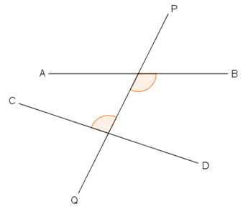
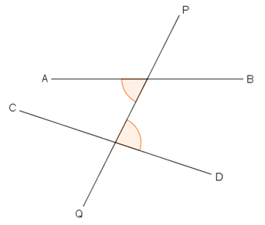
Alternate angles
c
d
h
i
For these two pairs of angles, the angles in each pair are located on the opposite sides of the transversal PQ, and lie between lines AB and CD. They are called a pair of alternate angles.

Slide 6
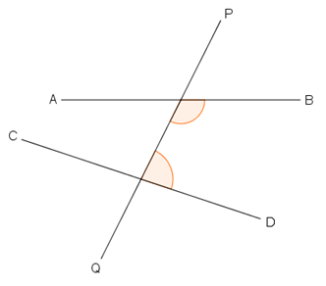
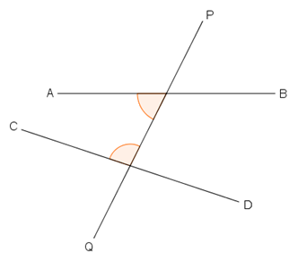
Interior angles on the same side of the transversal
c
d
i
h
As for the two pairs of angles shown above, each pair of angles are located on the same side of the transversal PQ and lie between lines AB and CD. They are called a pair of interior angles on the same side of the transversal.

Slide 7
~The End~

