Slide 1
Recognition of adjacent angles, angles at a point and vertically opposite angles

Slide 2
Adjacent Angles

Slide 3
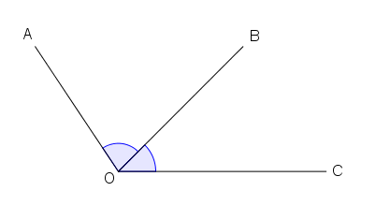
Adjacent angles
a
b
In the figure, a and b lie on different sides of their common arm OB.
They also have a common vertex O.
We call a and b a pair of adjacent angles.

Slide 4
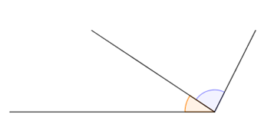
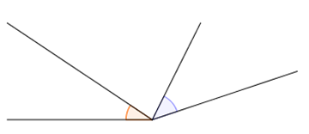


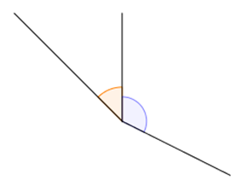
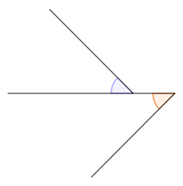
Adjacent angles
Which of the following pairs of angles are adjacent angles?
1.
2.
q
d
p
c
*no common arm
3.
4.
s
a
r
b
*no common vertex

Slide 5
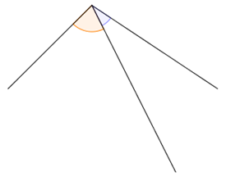
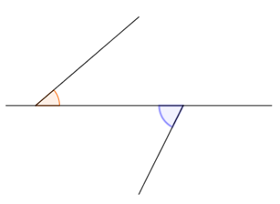
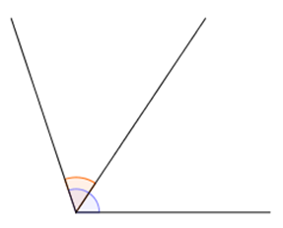
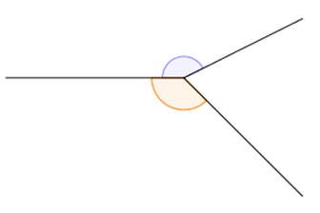
Adjacent angles
Which of the following pairs of angles are adjacent angles?
5.
6.
x
y
m
n
* no common vertex
7.
8.
u
h
w
k
*not lying on different sides of the common arm

Slide 6
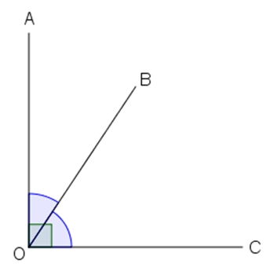
Adjacent angles
a
b
If the pair of adjacent angles a and b together form a right angle (i.e. 90°),
a and b are said to be complementary.
They are called complementary angles.

Slide 7
Adjacent angles
a
b
We can say:
a is a complementary angle of b,
and b is a complementary angle of a.

Slide 8
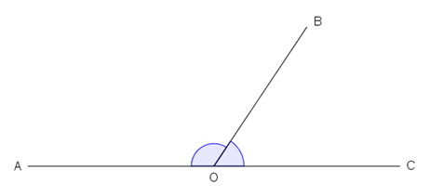
Adjacent angles
a
b
If AOC is a straight line,
then we call a and b a pair of adjacent angles on a straight line.

Slide 9
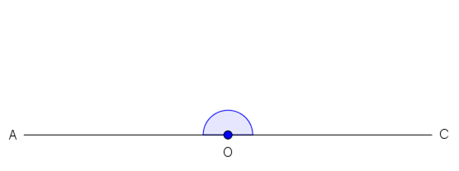


Adjacent angles
Do you remember what type of $∠$AOC is?
What is the size of $∠$AOC ?
Straight angle
180°
Take a look at a and b again in the figure on the left.
What do you discover?
a
b

Slide 10


Adjacent angles
a
b
When AOC is a straight line,
$∠$AOC becomes a straight angle (i.e. 180°).
$∴$ a + b $=$ 180°

Slide 11
Adjacent angles
a
b
When the pair of adjacent angles a and b together form a straight angle (i.e. 180°), a and b are said to be supplementary. They are called supplementary angles, (i.e. a is a supplementary angle of b, and b is a supplementary angle of a).

Slide 12
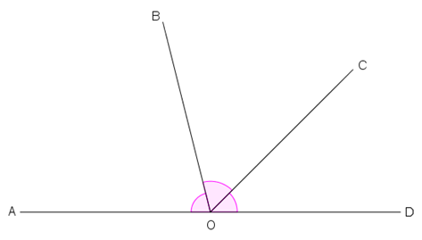
Adjacent angles
Let’s focus on the following figure.
b
a
c
AOD is a straight line. The angles a, b and c have a common vertex O.
Besides, a and b, b and c are two pairs of adjacent angles.
The angles a, b and c are also called adjacent angles on a straight line.

Slide 13
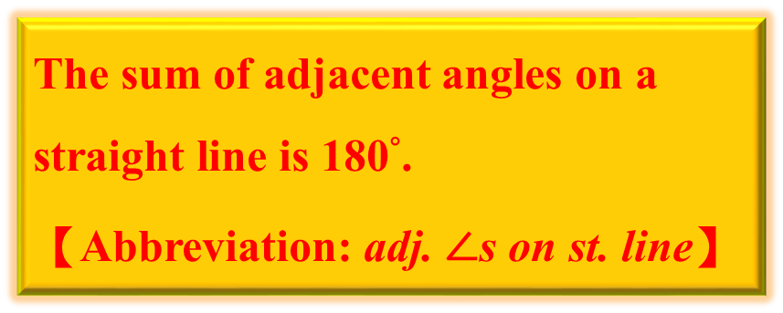


Adjacent angles
$∵$ AOD is a straight line
$∴∠$AOD $=$ 180°
$∴$ a + b + c $=$ 180°
b
a
c
Conclusion:
The sum of adjacent angles on a straight line is 180°.
【Abbreviation: adj. $∠$s on st. line】

Slide 14
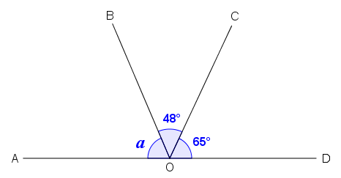



Example & Application
In the figure, AOD is a straight line. Find a.
$∠$AOB + $∠$BOC + $∠$COD $=$ 180° (adj. $∠$s on st. line)
a + 48° + 65° $=$ 180°
Don’t forget to write the abbreviation.
a + 113° $=$ 180°
a $=$ 67°

Slide 15
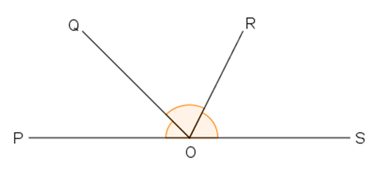

Adjacent angles
q
p
r
Conversely, if p + q + r $=$ 180° in the above figure,
we can conclude that POS is a straight line.

Slide 16
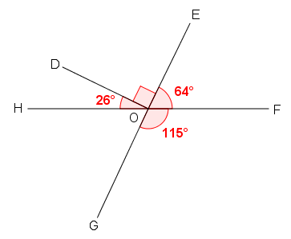







Example
In the figure,
(a) is HOF a straight line?
(b) is EOG a straight line?
(a) $∠$HOF $=$ 26° + 90° + 64°
(b) $∠$EOG $=$ 64° + 115°
$=$ 180°
$=$ 179°
$∴$ HOF is a straight line.
$≠$ 180°
$∴$ EOG is not a straight line.

Slide 17
Angles at a Point

Slide 18
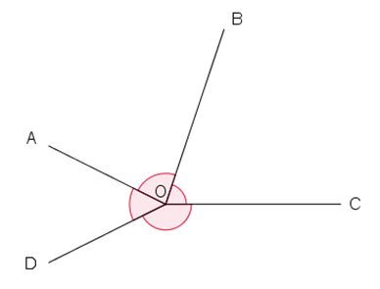
Angles at a point
a
b
d
c
In the figure, a, b, c and d have a common vertex O.
Also, a and b, b and c, c and d, d and a are four pairs of adjacent angles.
We call a, b, c and d angles at a point.

Slide 19
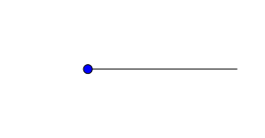

Angles at a point
What is the name of this type of angle? What is its size?
360°
Round angle
Now, look at a, b, c and d in the figure on the left. What can you conclude?
a
b
d
c

Slide 20
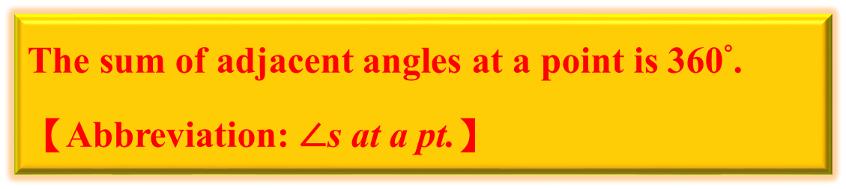

Angles at a point
The adjacent angles at a point
a, b, c and d form a round angle.
a
b
d
$∴$ a + b + c + d $=$ 360°
c
Conclusion:
The sum of adjacent angles at a point is 360°.
【Abbreviation: $∠$s at a pt.】

Slide 21
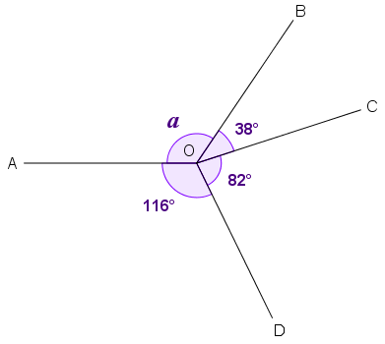




Example & Application
Find a in the figure.
$∠$AOB + $∠$BOC + $∠$COD + $∠$DOA $=$ 360° ($∠$s at a pt.)
a + 38° + 82° + 116° $=$ 360°
a + 236° $=$ 360°
a $=$ 124°

Slide 22
Vertically Opposite Angles

Slide 23
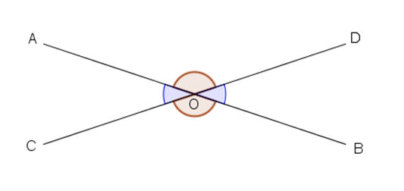
Vertically opposite angles
c
a
b
d
In the figure, two straight lines AB and CD intersect at O,
forming four angles a, b, c and d at a point.
The angles a and b have no common arm. We call a and b a pair of vertically opposite angles.
Similarly, c and d are another
pair of vertically opposite angles.

Slide 24
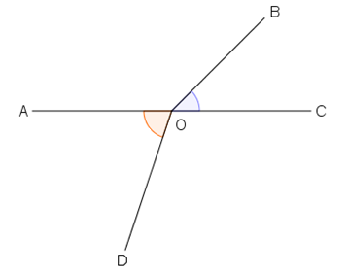
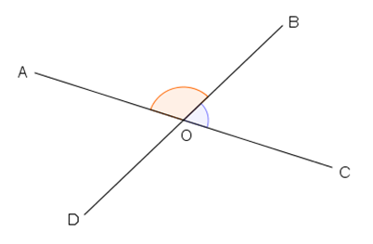
Vertically opposite angles
Which of the following pairs of angles are vertically opposite angles?
1. In the figure, AOC is a straight line.
2. In the figure, both AOC and BOD are straight lines.
c
b
d
a
*BOD is not a straight line.
*c and d have a common arm.

Slide 25
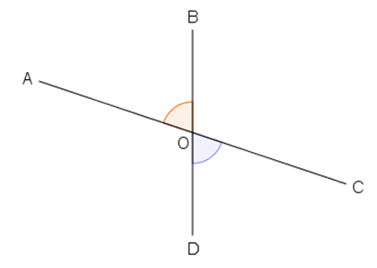
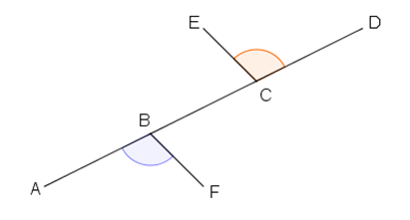
Vertically opposite angles
Which of the following pairs of angles are vertically opposite angles?
3. In the figure, both AOC and BOD are straight lines.
4. In the figure, ABCD is a straight line.
h
e
f
k
*h and k have no common vertex.

Slide 26




Vertically opposite angles
c
a
b
d
$∵$ COD is a straight line
$∴∠$COA + $∠$AOD $=$ 180° (adj. $∠$s on st. line)
a + c $=$ 180°
a $=$ 180° $−$ c

Slide 27




Vertically opposite angles
c
a
b
d
$∵$ AOB is also a straight line
$∴∠$AOD + $∠$DOB $=$ 180° (adj. $∠$s on st. line)
c + b $=$ 180°
b $=$ 180° $−$ c

Slide 28
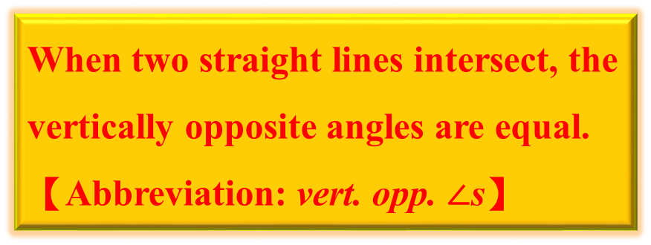


Vertically opposite angles
c
a
b
d
c
$∴$a $=$ b
Similarly, c $=$ d
Conclusion:
When two straight lines intersect, the vertically opposite angles are equal.
【Abbreviation: vert. opp. $∠$s】

Slide 29
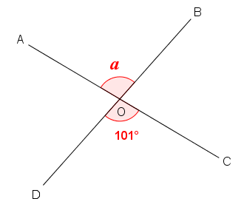


Example & Application
In the figure, both AOC and BOD are straight lines. Find a.
$∠$AOB $=$ $∠$COD (vert. opp. $∠$s)
a $=$ 101°

Slide 30
Exercise

Slide 31
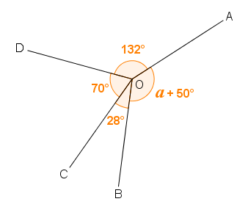



Exercise
1. Find a in the figure.
$∠$AOB + $∠$BOC + $∠$COD + $∠$DOA $=$ 360° ($∠$s at a pt.)
a + 50° + 28° + 70° + 132° $=$ 360°
a + 280° $=$ 360°
a $=$ 80°

Slide 32
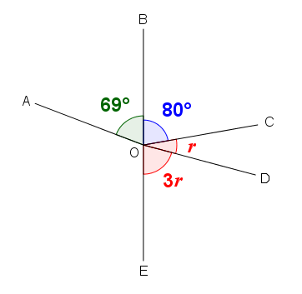



Exercise
2. In the figure, BOE is a straight line.
(a) Find r.
(b) Is AOD a straight line?
= 25°
(a) $∠$DOE + $∠$COD + $∠$BOC $=$ 180° (adj. $∠$s on st. line)
3r + r + 80° $=$ 180°
4r $=$ 100°
r $=$ 25°

Slide 33





Exercise
2. In the figure, BOE is a straight line.
(a) Find r.
(b) Is AOD a straight line?
= 25°
(b) $∠$AOD $=$ r + 80° + 69°
$=$ 25° + 80° + 69°
$=$ 174°
$≠$ 180°
$∴$ AOD is not a straight line.

Slide 34
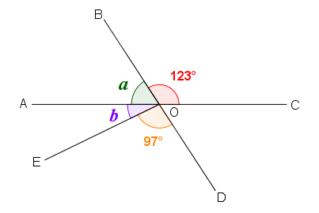



Exercise
3. In the figure, AOC and BOD are straight lines. Find a and b.
$∠$AOB + $∠$BOC $=$ 180° (adj. $∠$s on st. line)
a + 123° $=$ 180°
a $=$ 57°

Slide 35




Exercise
3. In the figure, AOC and BOD are straight lines. Find a and b.
Any alternative method?
$∠$AOD $=$ $∠$BOC (vert. opp. $∠$s)
$∠$AOE + $∠$EOD $=$ $∠$BOC
b + 97° $=$ 123°
b $=$ 26°

Slide 36
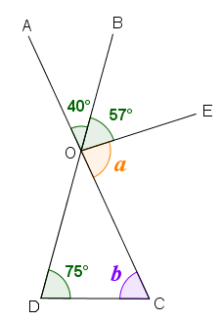



Exercise
4. In the figure, AOC and BOD are straight lines. Find a and b.
$∠$COE + $∠$EOB + $∠$BOA $=$ 180° (adj. $∠$s on st. line)
a + 57° + 40° $=$ 180°
a + 97° $=$ 180°
a $=$ 83°

Slide 37






Exercise
4. In the figure, AOC and BOD are straight lines. Find a and b.
$∠$DOC $=$ $∠$AOB (vert. opp. $∠$s)
$=$ 40°
$∠$OCD + $∠$CDO + $∠$DOC $=$ 180° ($∠$sum of △)
b + 75° + 40° $=$ 180°
b + 115° $=$ 180°
b $=$ 65°

Slide 38
~The End~

