Slide 1
Properties of angles related with parallel lines

Slide 2
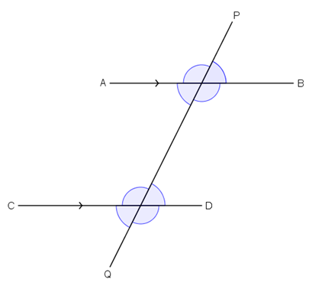
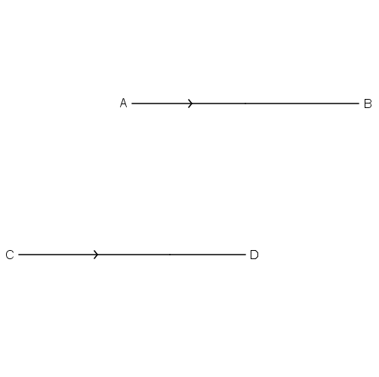
Angles formed by parallel lines and their transversal
P
a
b
d
c
h
i
k
j
Q
If AB and CD are a pair of parallel lines and PQ is their transversal,
the angles formed at the intersections will have the following properties.

Slide 3
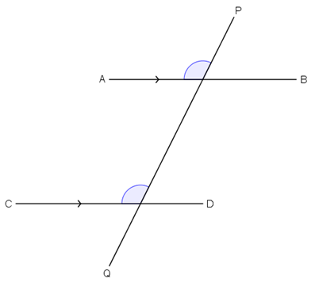
Corresponding angles
The angles a and h are a pair of corresponding angles.
a
Move a to the position of h.
h
We see that a = h.

Slide 4
Corresponding angles
Conclusion:
a
1. The corresponding angles are equal,
h
i.e. if AB//CD, then a = h.
【Abbreviation: corr. $∠$s, AB//CD】

Slide 5
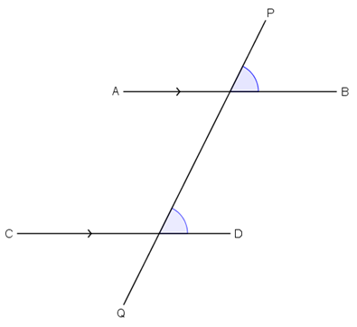
Corresponding angles
Similarly,
b
if AB//CD, then b = i.
i
【Abbreviation: corr. $∠$s, AB//CD】

Slide 6
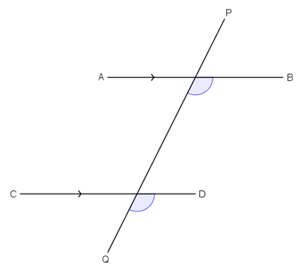
Corresponding angles
Similarly,
c
if AB//CD, then c = j.
j
【Abbreviation: corr. $∠$s, AB//CD】

Slide 7
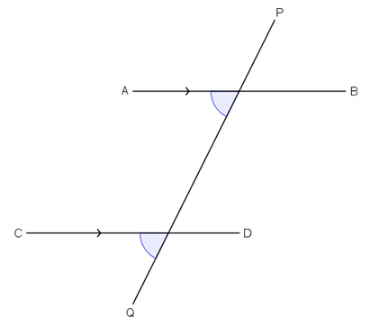
Corresponding angles
Similarly,
d
if AB//CD, then d = k.
k
【Abbreviation: corr. $∠$s, AB//CD】

Slide 8
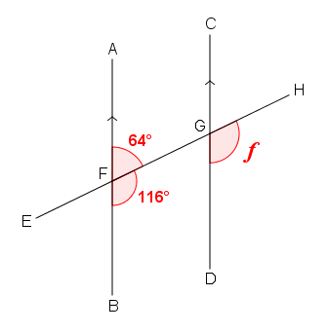
Corresponding angles
Example:
In the figure, AB//CD. The straight line EH intersects AB and CD at F and G respectively. Find f.
$∠$HGD = $∠$GFB (corr. $∠$s, AB//CD)
f = 116$\text{°}$

Slide 9
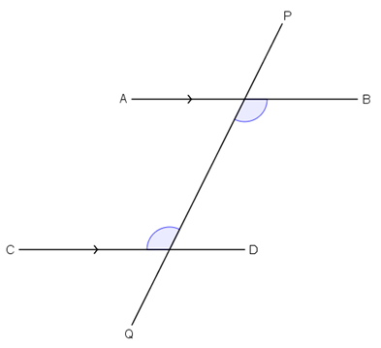
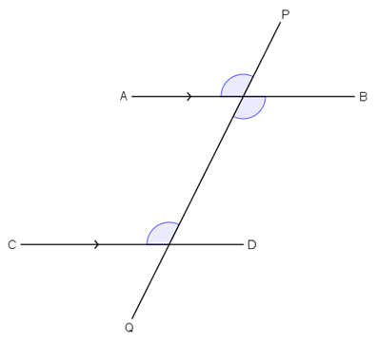
Alternate angles
The angles c and h are a pair of alternate angles.
a
c = a (vert. opp. $∠$s)
c
a = h (corr. $∠$s, AB//CD)
h
$∴$ c = h

Slide 10
Alternate angles
Conclusion：
2. The alternate angles are equal,
c
i.e. if AB//CD, then c = h.
h
【Abbreviation: alt. $∠$s, AB//CD】

Slide 11
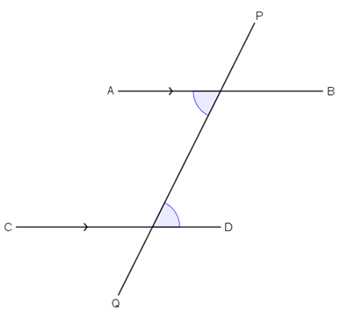
Alternate angles
Similarly,
if AB//CD, then d = i.
d
i
【Abbreviation: alt. $∠$s, AB//CD】

Slide 12
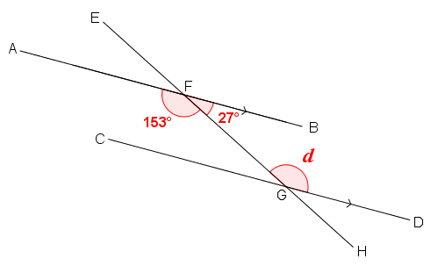
Alternate angles
Example:
In the figure, AB//CD. The straight line EH intersects AB and CD at F and G respectively. Find d.
$∠$FGD = $∠$AFG (alt. $∠$s, AB//CD)
d = 153$\text{°}$

Slide 13
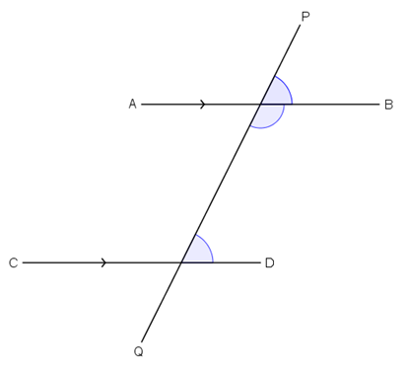
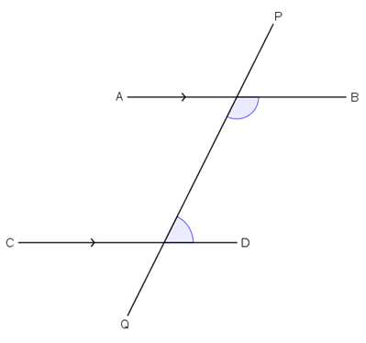
Interior angles on the same side of the transversal
The angles c and i are a pair of interior angles on the same side of the transversal.
b
c
c + b = 180$\text{°}$ (adj. $∠$s on st. line)
i
i = b (corr. $∠$s, AB//CD)
$∴$ c + i = 180$\text{°}$

Slide 14
Interior angles on the same side of the transversal
Conclusion:
3. The interior angles on the same side of the transversal are supplementary,
c
i
i.e. if AB//CD, then c + i = 180$\text{°}$.
【Abbreviation: int. $∠$s, AB//CD】

Slide 15
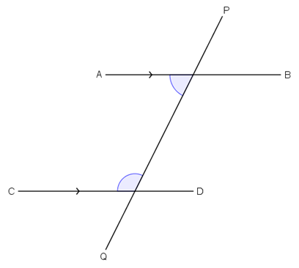
Interior angles on the same side of the transversal
Similarly,
if AB//CD, then d + h = 180$\text{°}$.
d
h
【Abbreviation: int. $∠$s, AB//CD】

Slide 16
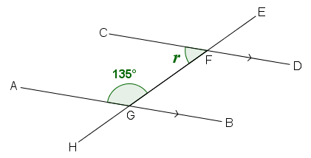
Interior angles on the same side of the transversal
Example:
In the figure, AB//CD.
The straight line EH intersects AB and CD at G and F respectively. Find r.
$∠$CFG + $∠$AGF = 180$\text{°}$ (int. $∠$s, AB//CD)
r + 135$\text{°}$ = 180$\text{°}$
r = 45$\text{°}$

Slide 17
Exercise

Slide 18
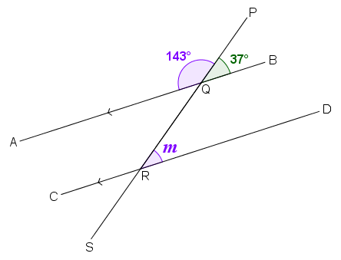
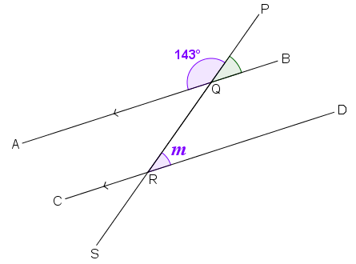
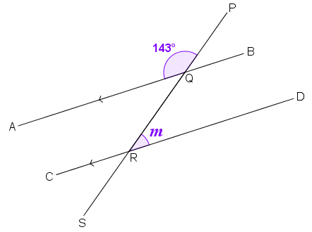
Exercise
Any other method?
1. In the figure, AB//CD. The straight line PS intersects AB and CD at Q and R respectively. Find m.
Method(2)
Method(3)
$∠$PQB + $∠$PQA $=$ 180° (adj. $∠$s on st. line)
$∠$PQB + 143° $=$ 180°
$∠$PQB $=$ 37°
$∠$QRD $=$ $∠$PQB (corr. $∠$s, AB//CD)
Next Question
m $=$ 37°

Slide 19
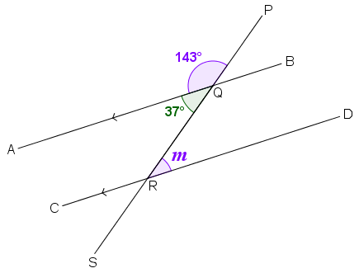
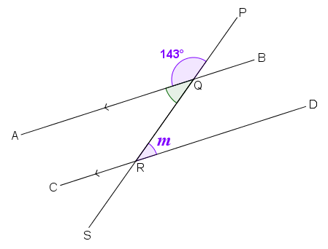
Exercise
1. In the figure, AB//CD. The straight line PS intersects AB and CD at Q and R respectively. Find m.
Method(1)
Method(3)
$∠$AQR + $∠$AQP $=$ 180° (adj. $∠$s on st. line)
$∠$AQR + 143° $=$ 180°
$∠$AQR $=$ 37°
$∠$QRD $=$ $∠$AQR (alt. $∠$s, AB//CD)
Next Question
m $=$ 37°

Slide 20
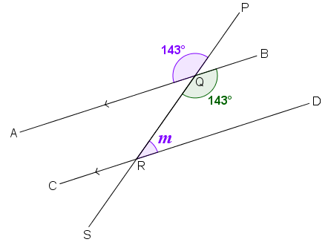
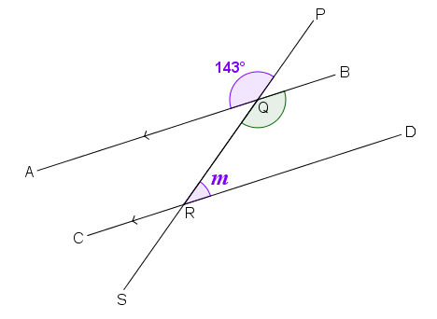
Exercise
1. In the figure, AB//CD. The straight line PS intersects AB and CD at Q and R respectively. Find m.
Method(1)
Method(2)
$∠$BQR $=$ $∠$PQA (vert. opp. $∠$s)
$∠$BQR $=$ 143°
$∠$QRD + $∠$BQR $=$ 180° (int. $∠$s, AB//CD)
m + 143° $=$ 180°
Next Question
m $=$ 37°

Slide 21
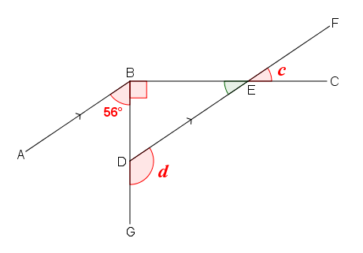
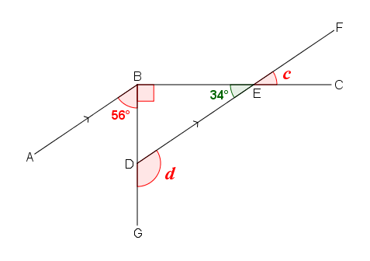
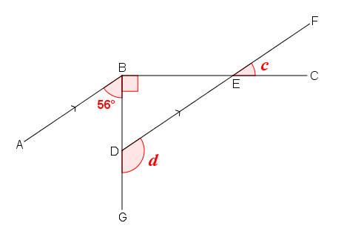
Exercise
2. In the figure, BDG, BEC, DEF are straight lines and AB//DF. Find c and d.
$∠$BED + $∠$ABC $=$ 180° (int. $∠$s, AB//DF)
$∠$BED + 56° + 90° $=$ 180°
$∠$BED + 146° $=$ 180°
$∠$BED $=$ 34°
$∠$FEC $=$ $∠$BED (vert. opp. $∠$s)
c $=$ 34°

Slide 22
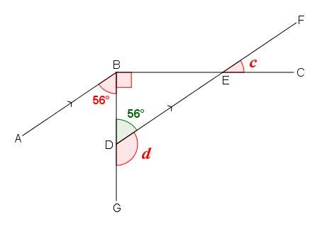
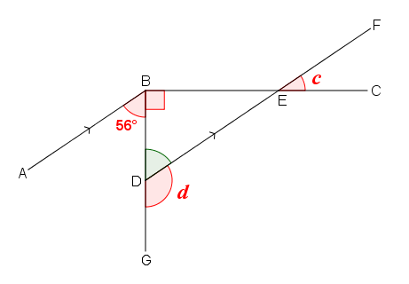
Exercise
2. In the figure, BDG, BEC, DEF are straight lines and AB//DF. Find c and d.
$∠$BDE $=$ $∠$ABD (alt. $∠$s, AB//DF)
$∠$BDE $=$ 56°
$∠$GDE + $∠$BDE $=$ 180° (adj. $∠$s on st. line)
d + 56° $=$ 180°
d $=$ 124°

Slide 23
~The End~

